Slide 1
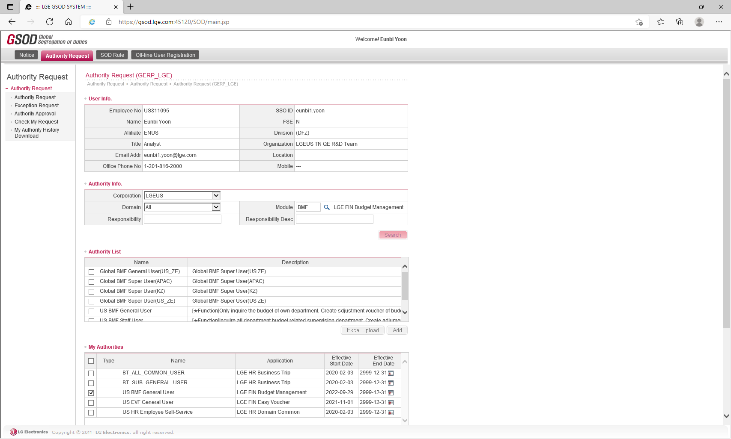
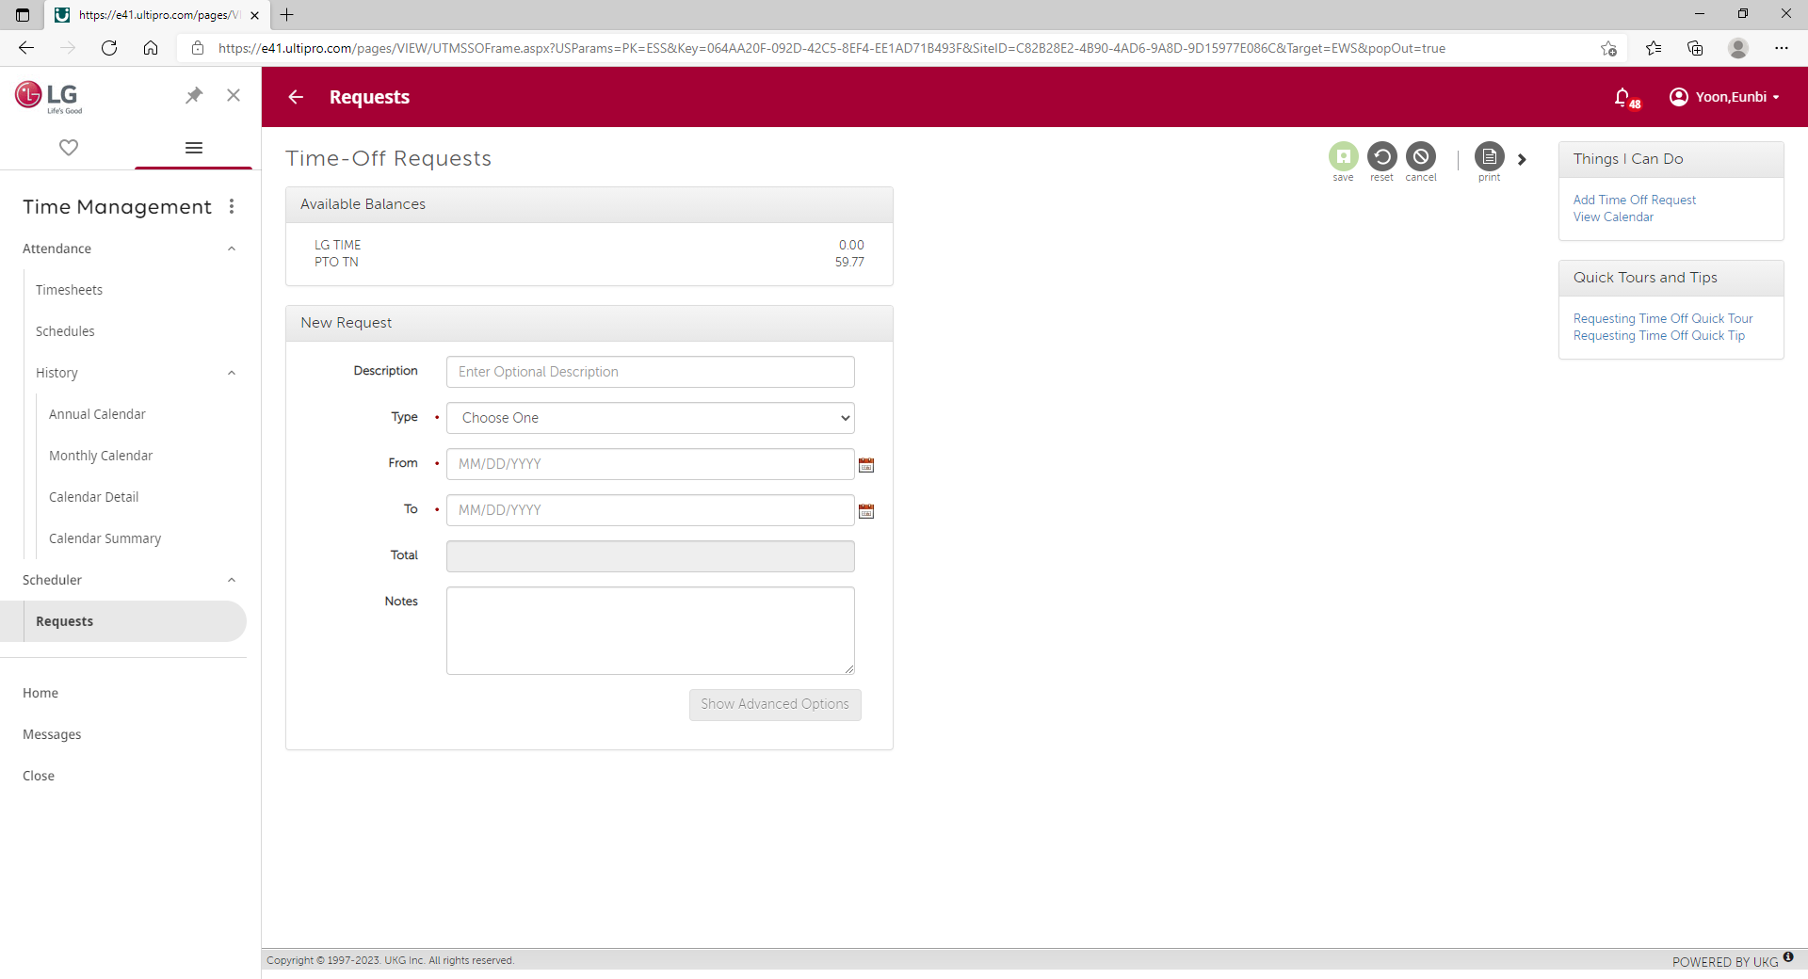
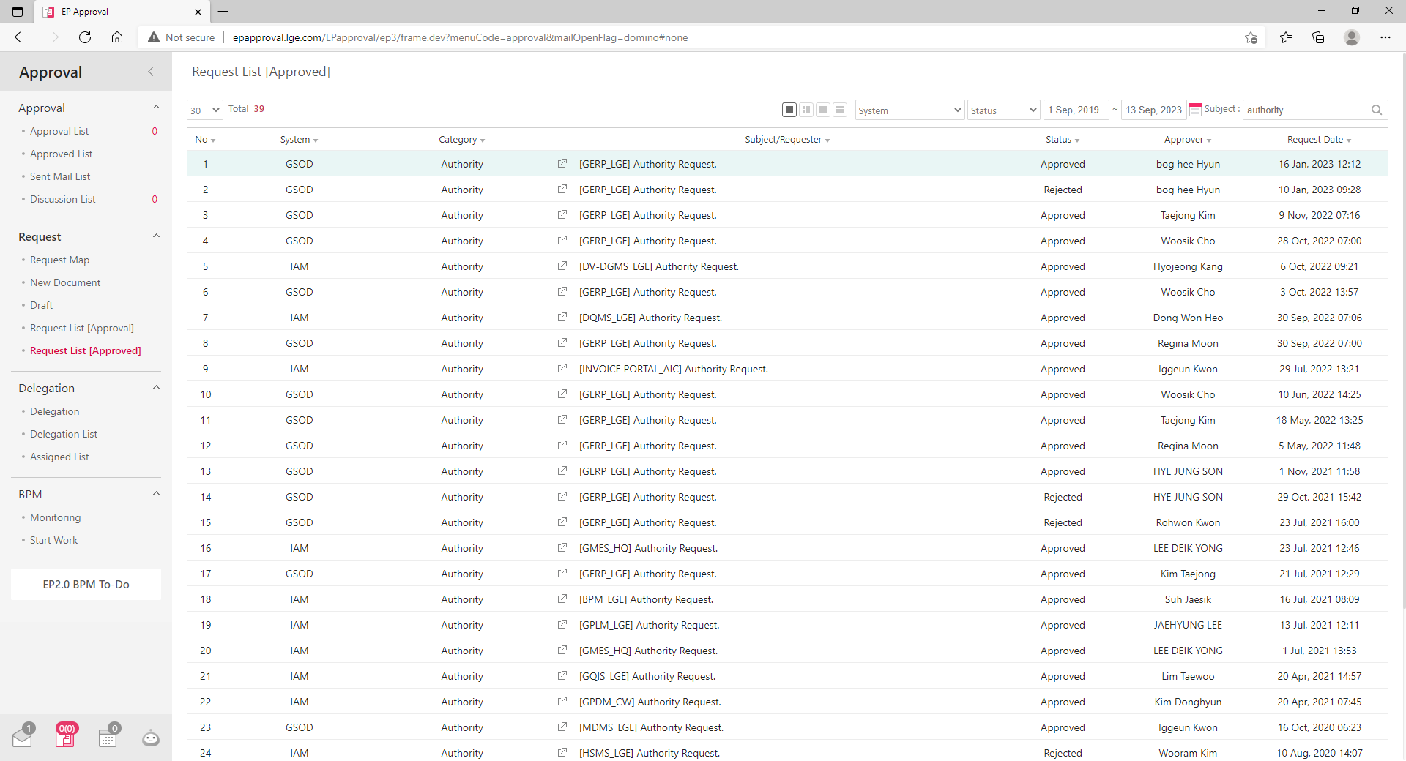
0. Security Center Main
You should log in to access this website and if you are logout it when you click some buttons to move page you will connect to login page automatically
When you log in, it shows your authority, First and Last name on the Top Right side
Website has two types of accounts authority, Admin and User. User Authority is approval requester and Admin Authority is approver, usually security member
Map
Admin Location
Function
Manager
Security Building Manager,
SHEE Team PIC, Developer
Visitor Portal
Security Building
Visitor Registration, Visitor Parking Pass
Account
Admin
Security Building Staff,
Security Gate2 Staff
Parking Portal
Security Building,
Gate2 Security
Parking Pass Request, Parking Violator,
Employee of Month
Security Center
User
LGETN All Member
Truck Portal
Gate2 Security
Truck Check-In, Out
inked with LX Pantos USA.
Delivery Portal
Security Building
Generate Package List to Search and Check-Out Package
System Design Idea Comes From LG System
This site has been developed as a reference for the various operating methods of the LG system to provide a friendly LG’s user experience.
Account Authority
Request Function
Approval Function
LG NewEP Authority
Provides System
: IAM, GSOD
LG4ME PTO
Request System
: Time Management
LG NewEP
Approval System
: EP Approval

Slide 2
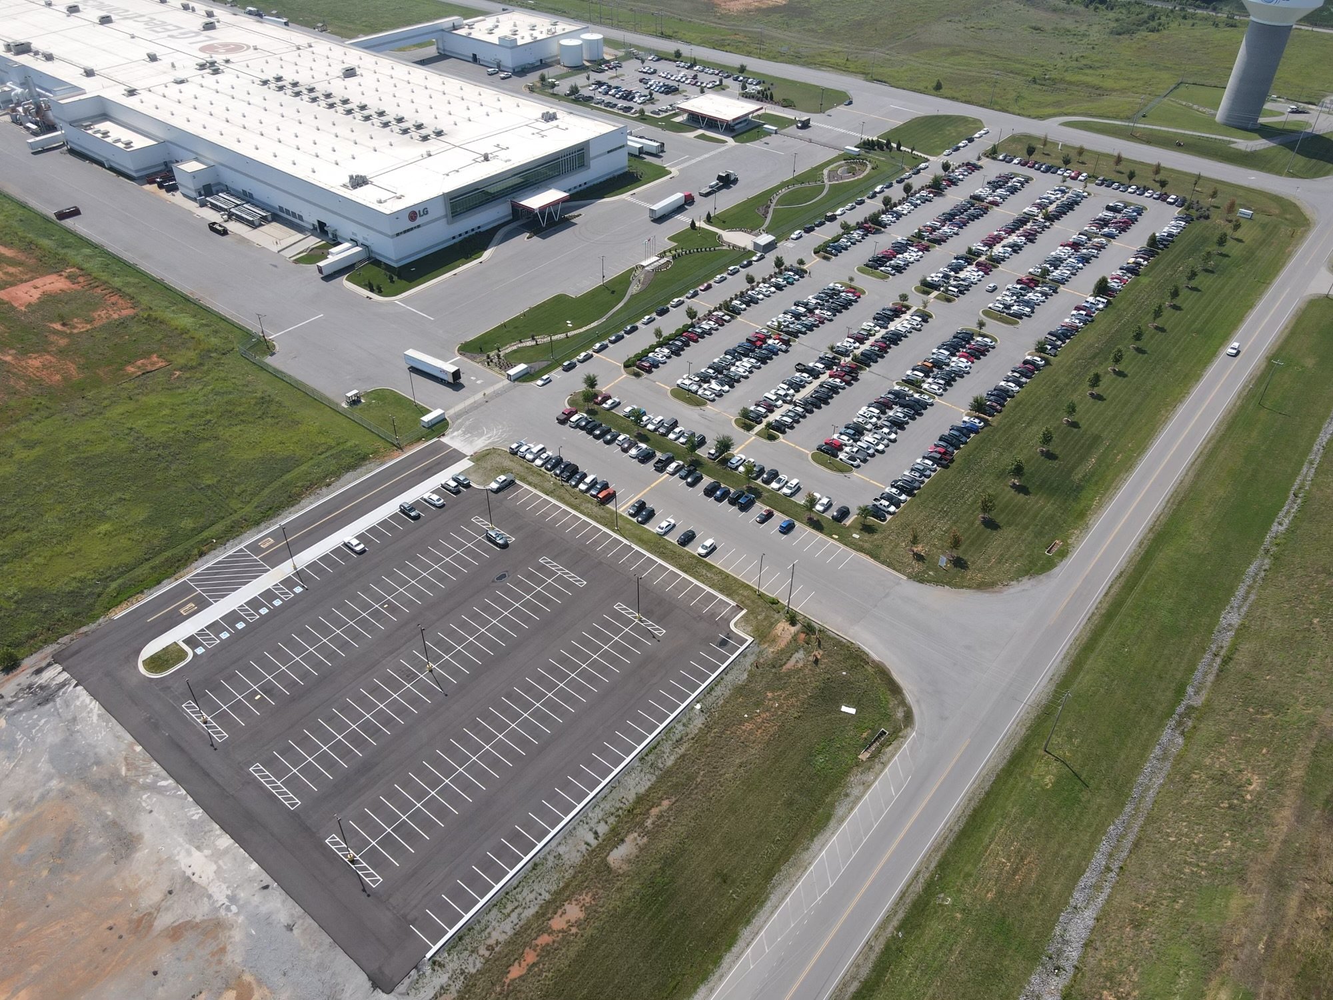
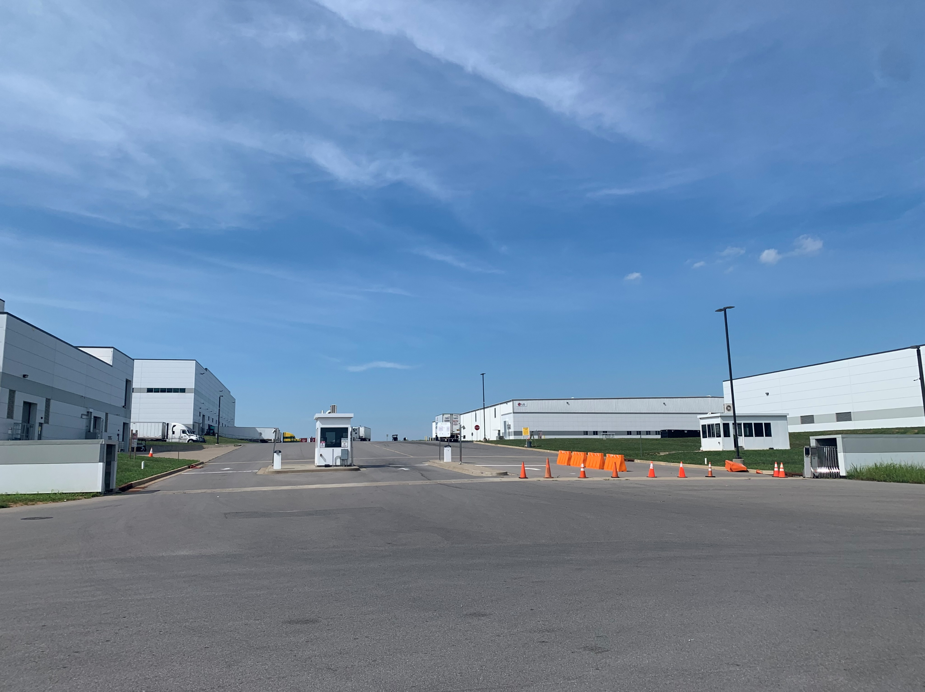
Appendix. Security Admin Location
Security Building
Gate2 Security

Slide 3
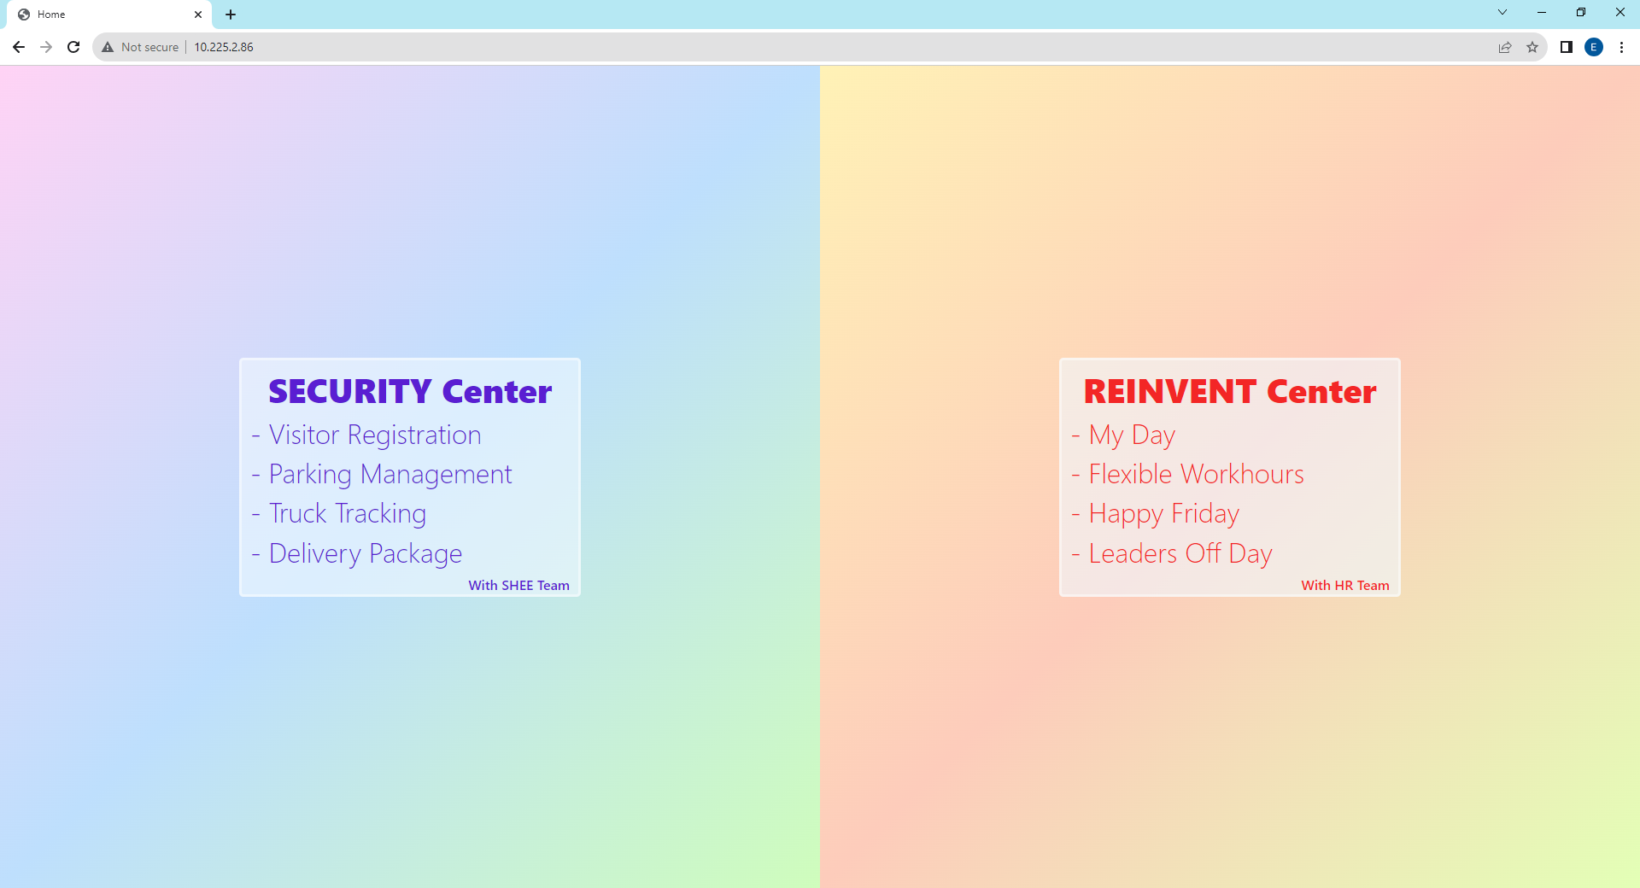
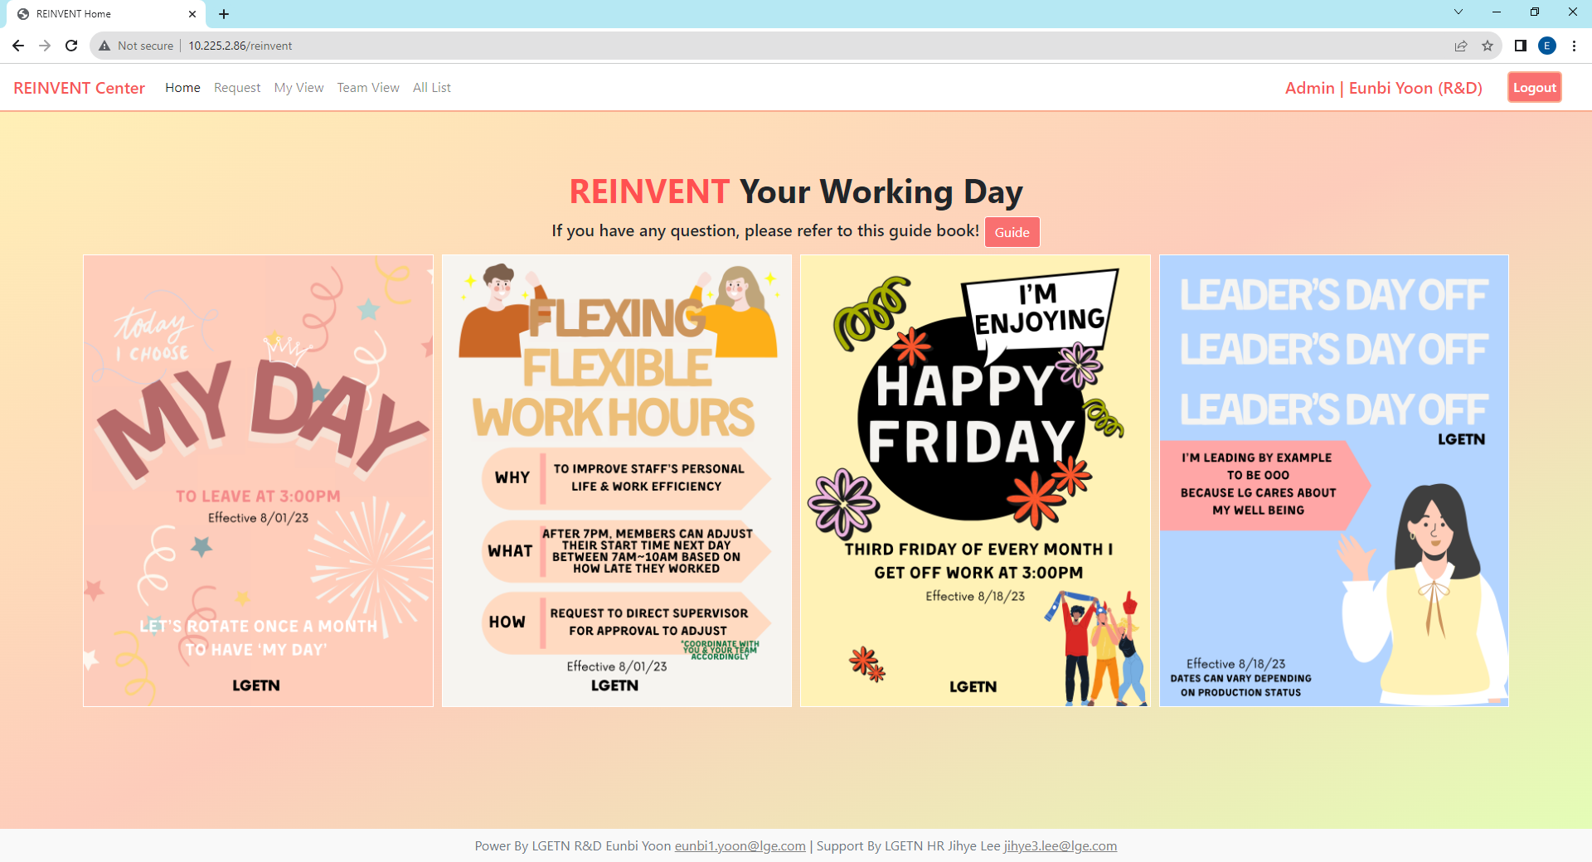
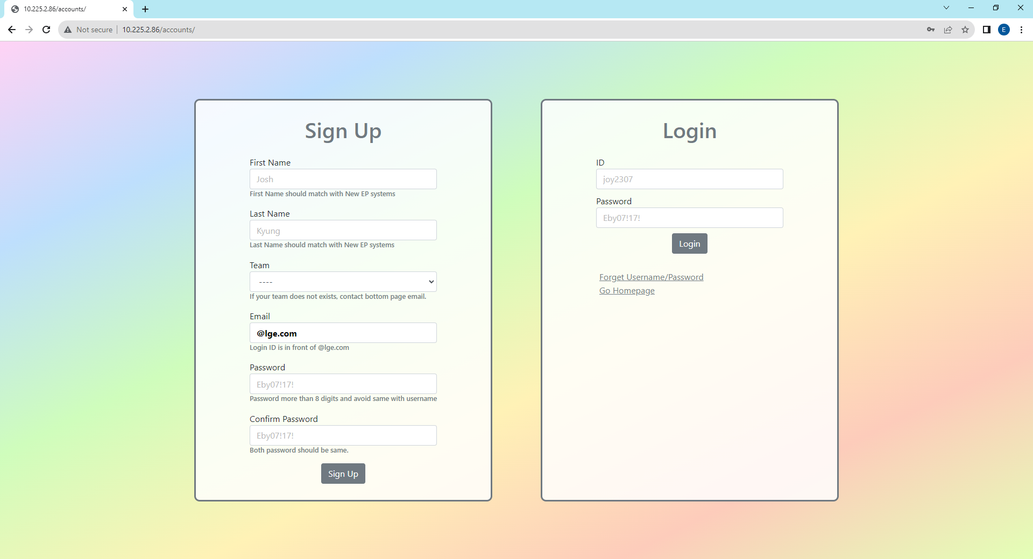
1. Sign Up & Login Page
You should log in to access this website and if you are logout it when you click some buttons to move page you will connect to login page automatically
When you sign up here, you will get user authority, if you need Admin Authority then send your all sign up information referring sign-up form (eunbi1.yoon@lge.com)
For sign up, all blanks are required and check detailed requirements below blanks and password different with username. e.g. username : user, password : user1357(X).
Email address should be @lge.com for security purpose.
Main Page
Log-In
Authority | First Name Last Name (Team Name)
If you are already login, it will link you to this page
Click this field if you want to move to reinvent center
Log-Out

Slide 4
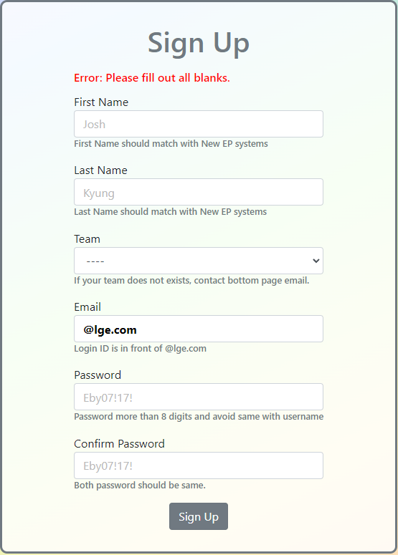
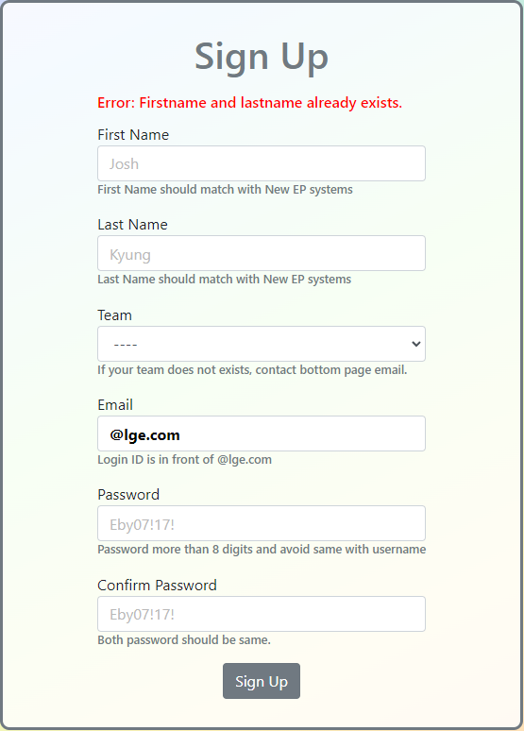
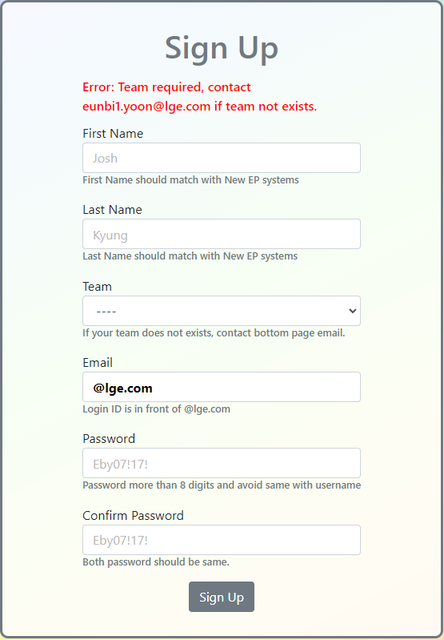



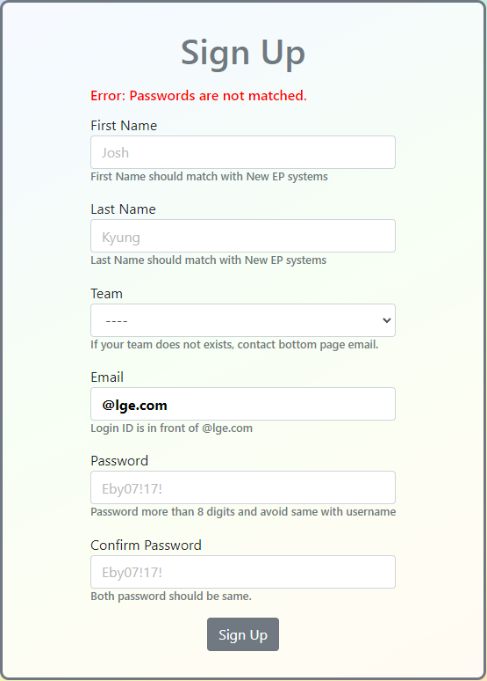
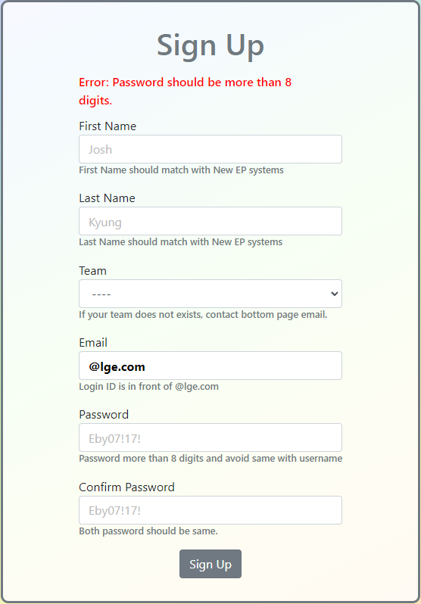
1. Sign Up Page – Error Logic
Serialized Structure : Define all occurred errors and you can make accounts when you avoid all these errors below
N
N : No Error Exist
Error 1
N
Error 2
N
Error 3
Error 4
N
Error 5
N
Error 6
N
Error 7
N
True
Error 1. Did not fill out all blanks
→ Fill out all blanks
Error 2. Accounts already exists
→ Try “Forget Username
/Password” in Login Section
Error 3. Not Select Team
→ Select your team, if there is no your team contact admin.
Error 4. Email Already Exists
→ Try “Forget Username
/Password” in Login Section
Error 5. email address has no “@”
→ Email address Add “@”
Error 6. Email Address Not lge.com
→ Check Email address is @lge.com
Error 7. Password is not matching
→ Check Password and Confirm Password are matching
Error 8. Password shorter than 8 digits → Password Length can be same or larger than 8 digits

Slide 5

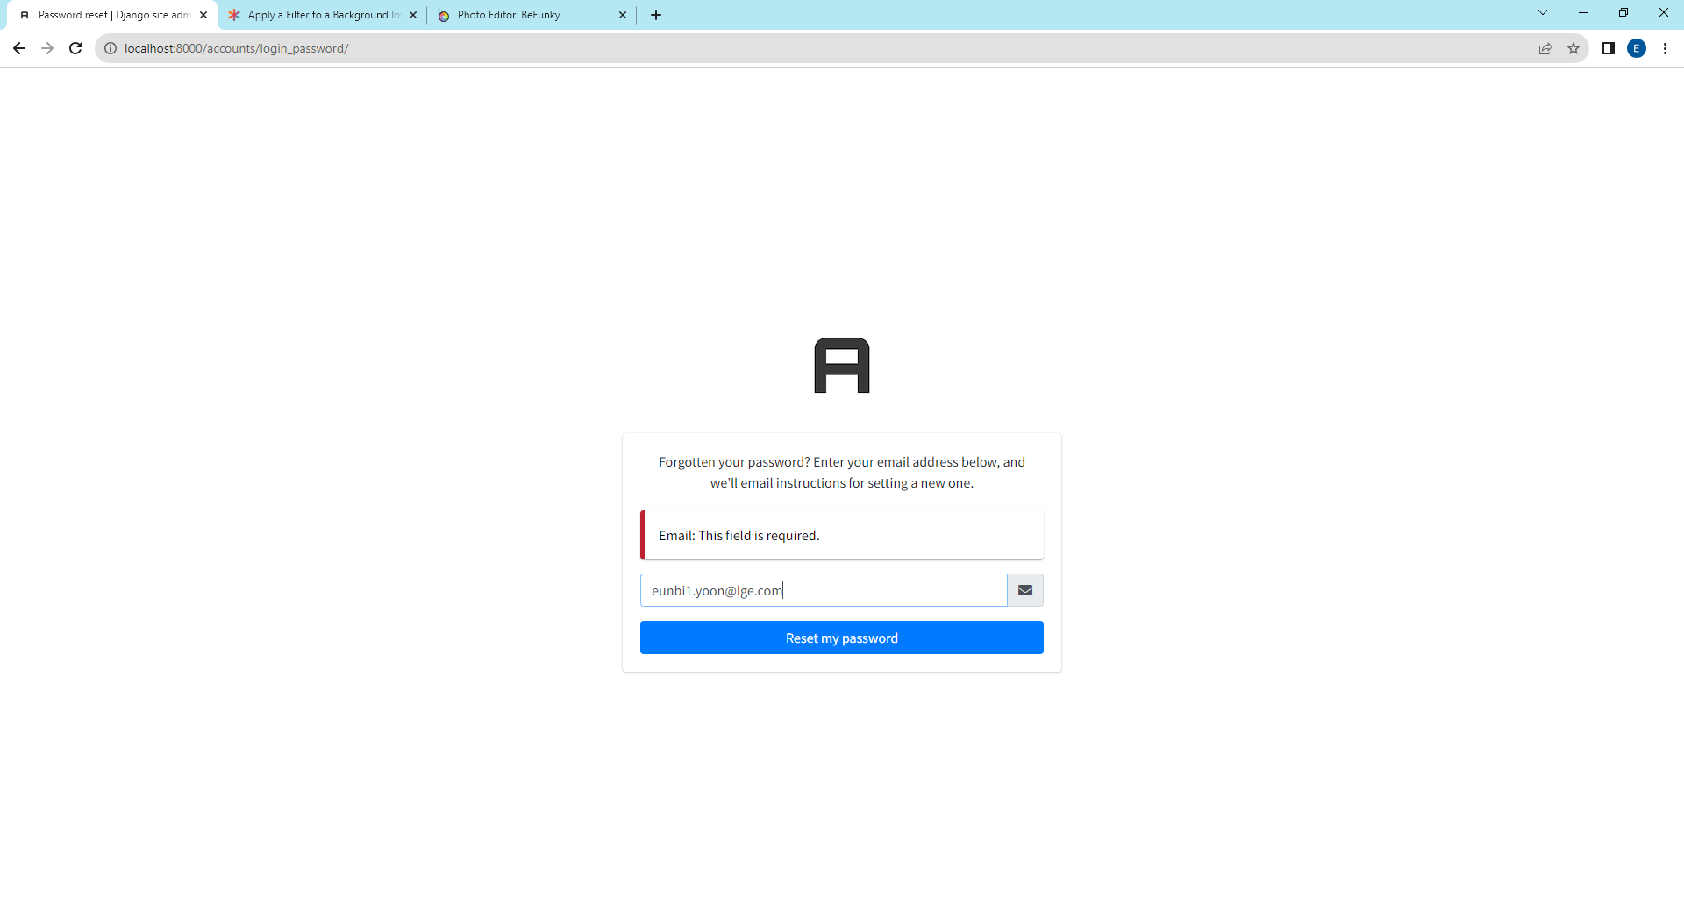
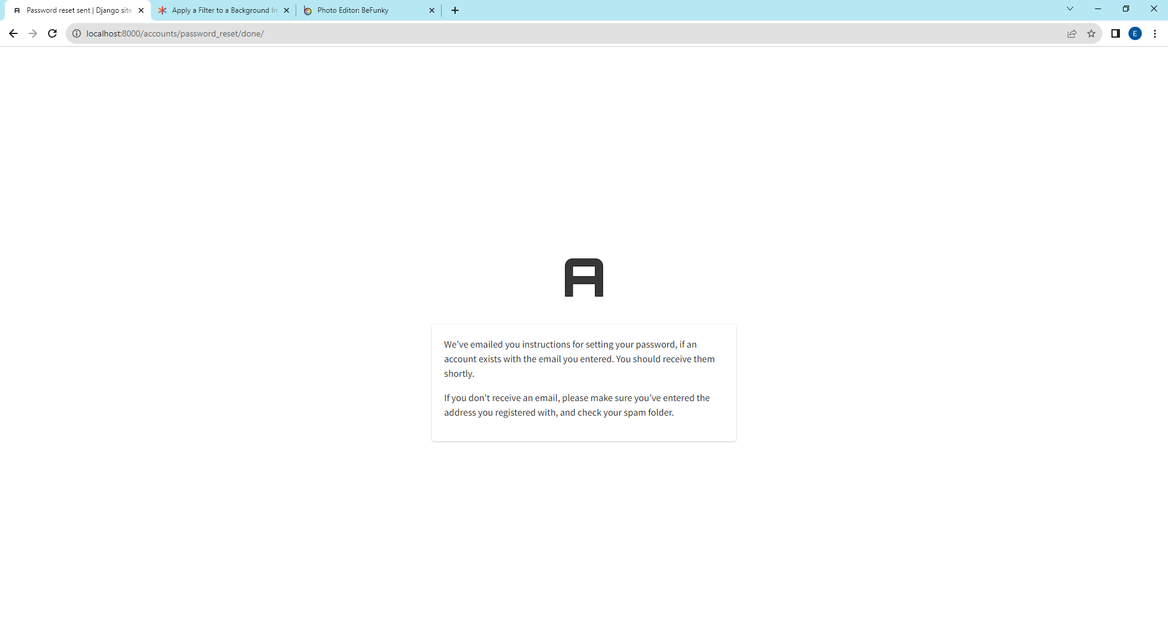
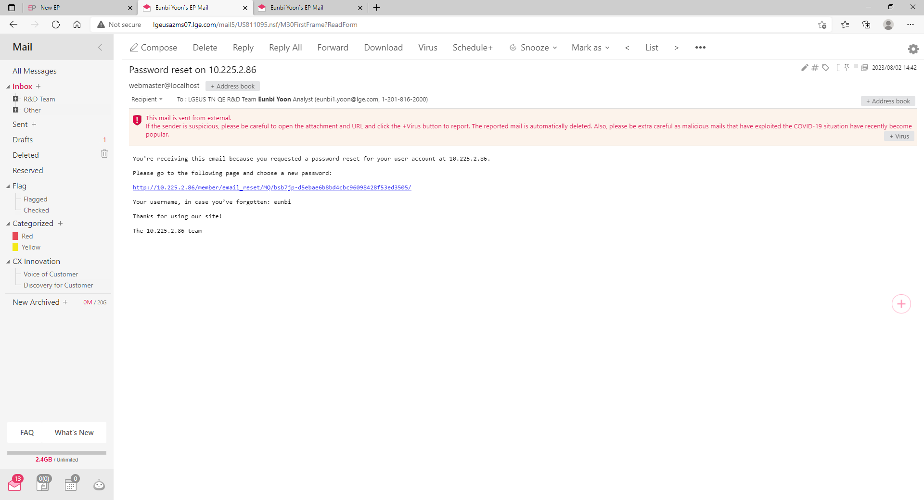
1. Sign Up, Log In Page - Forget Username/Password
If you forget password or username, please click “Forget Username/Password”. You will receive email showing username and password reset link.
Click the link to reset your password and this link is only valid for 10 minutes. If you passed 10 minutes, then click “Forget Username/Password” once again.
1
2
Click to send password reset link and username information to your email and there is no limit of this request.
It should be matched with email that you fill when sign up.
After this, click reset my password
3
4
Subject Line: Password reset on 10.225.2.86
Password can be reset if you click this link
You can check your username
Check email sending confirmation message

Slide 6
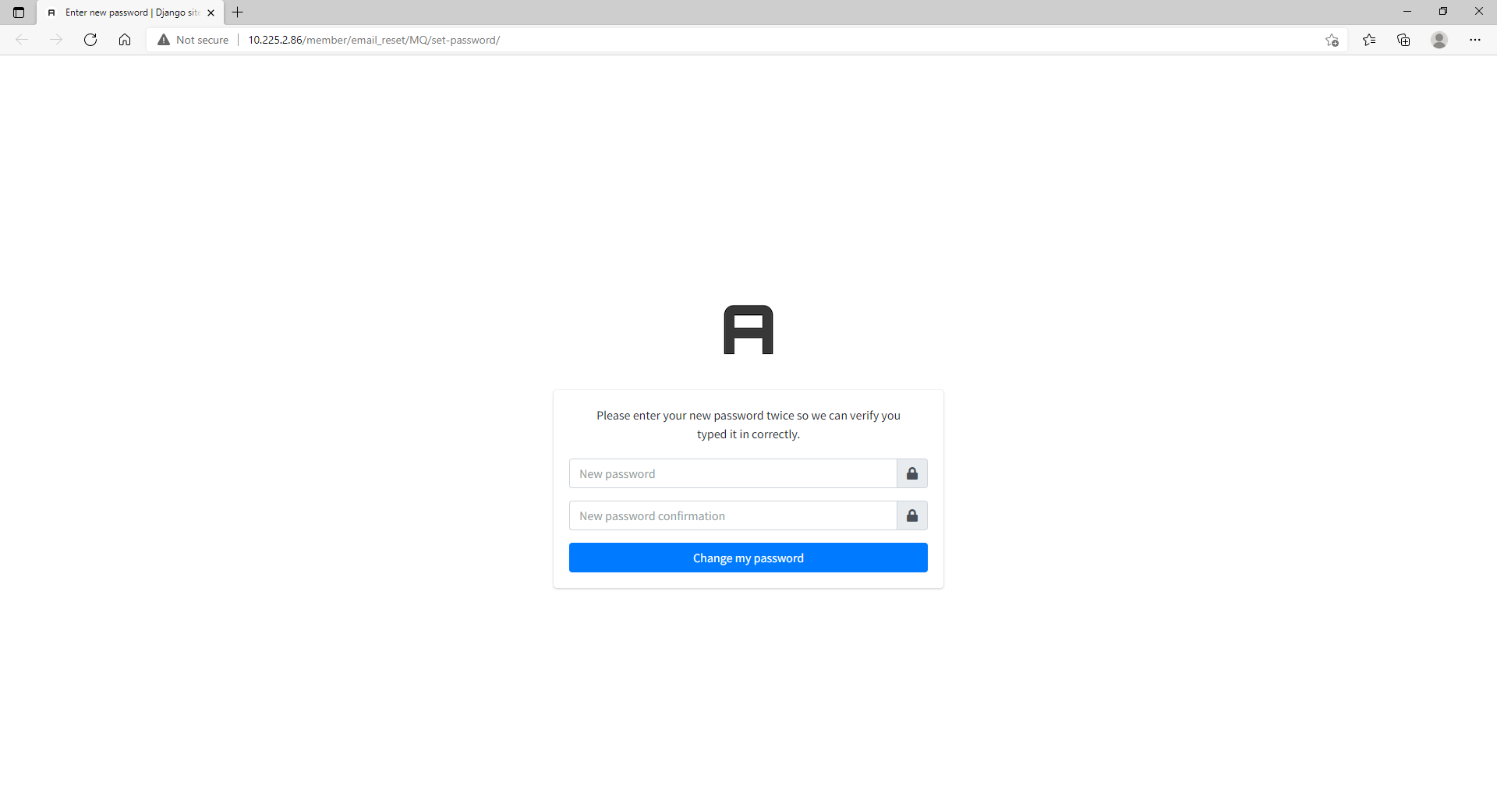
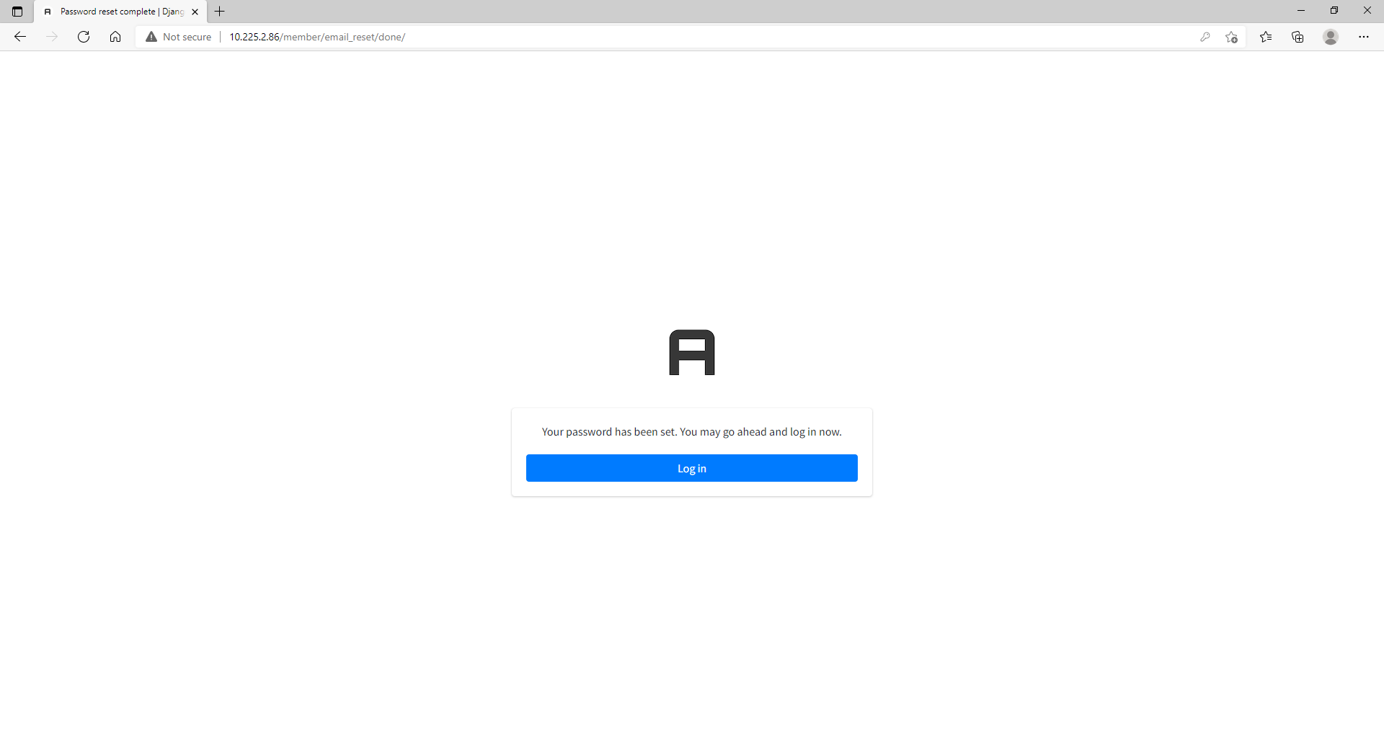
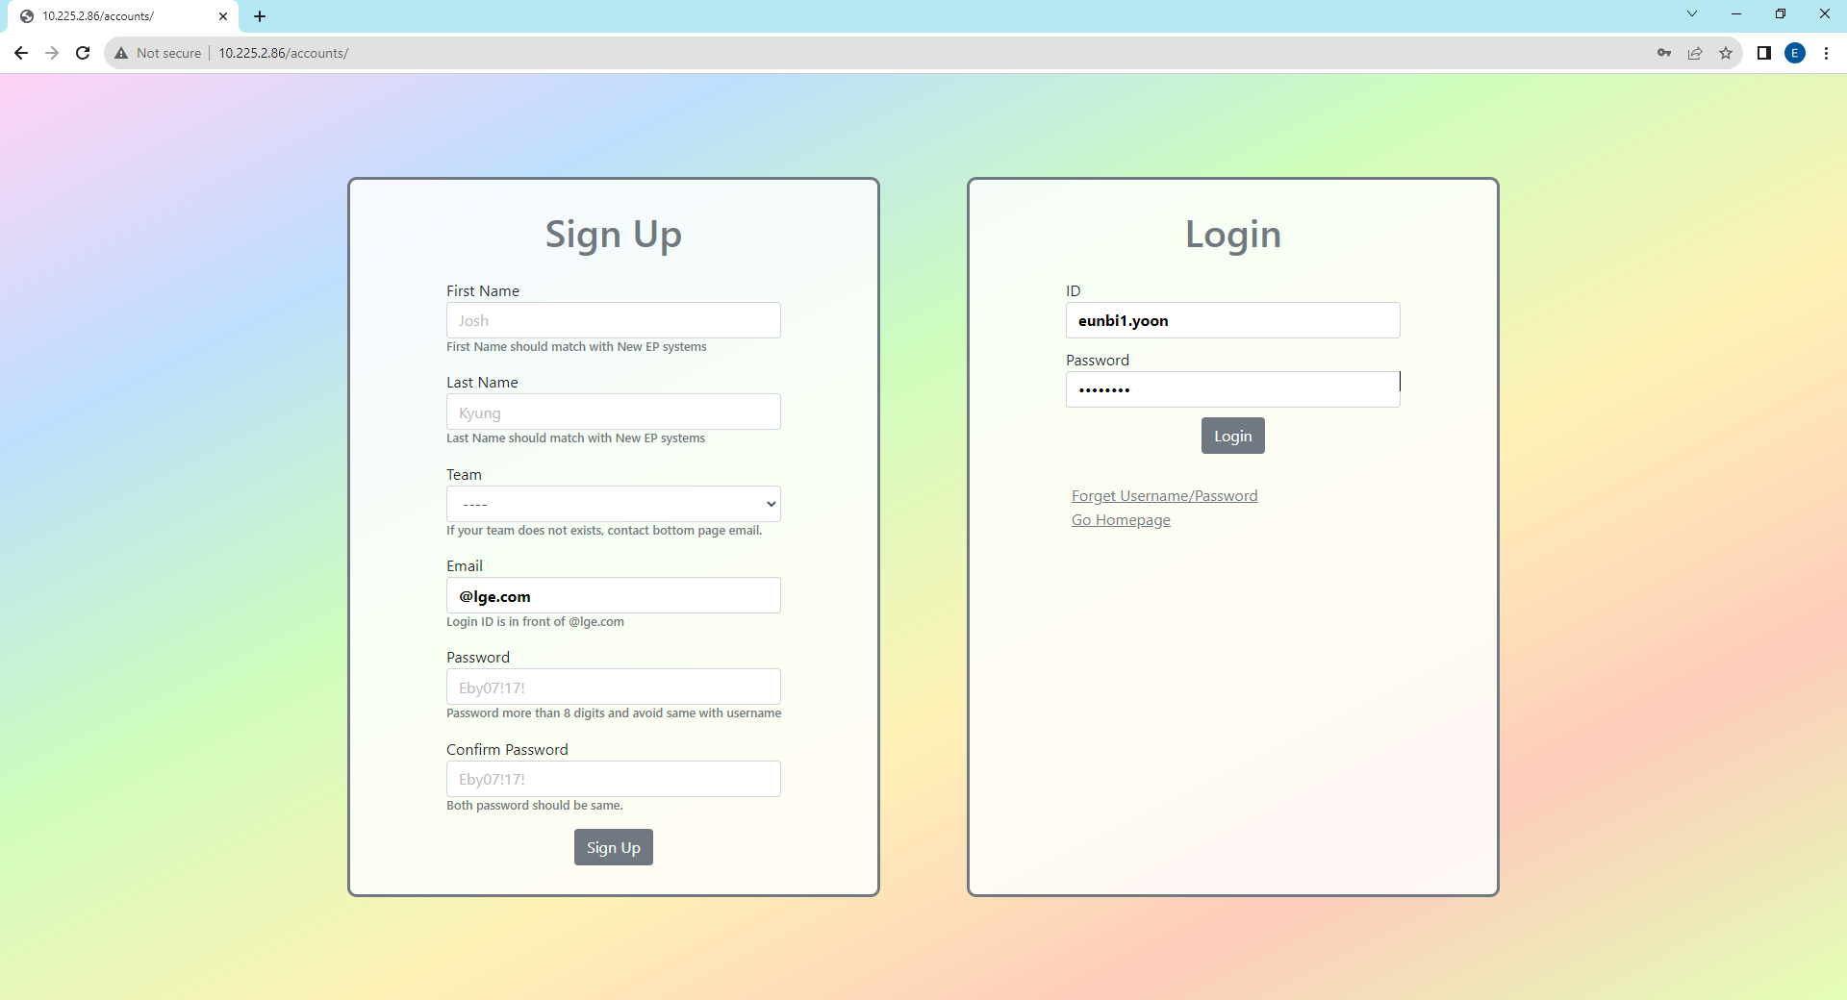

1. Sign Up, Log In Page - Forget Username/Password
If you forget password or username, please click “Forget Username/Password”. You will receive email showing username and password reset link.
When you enter email address to reset your password, it should be LG Email(@lge.com) and match with email address that you sign up.
5
6
Enter New Password
Click the link to go to login page
7
8
Successfully login to your account
Login with new password

Slide 7
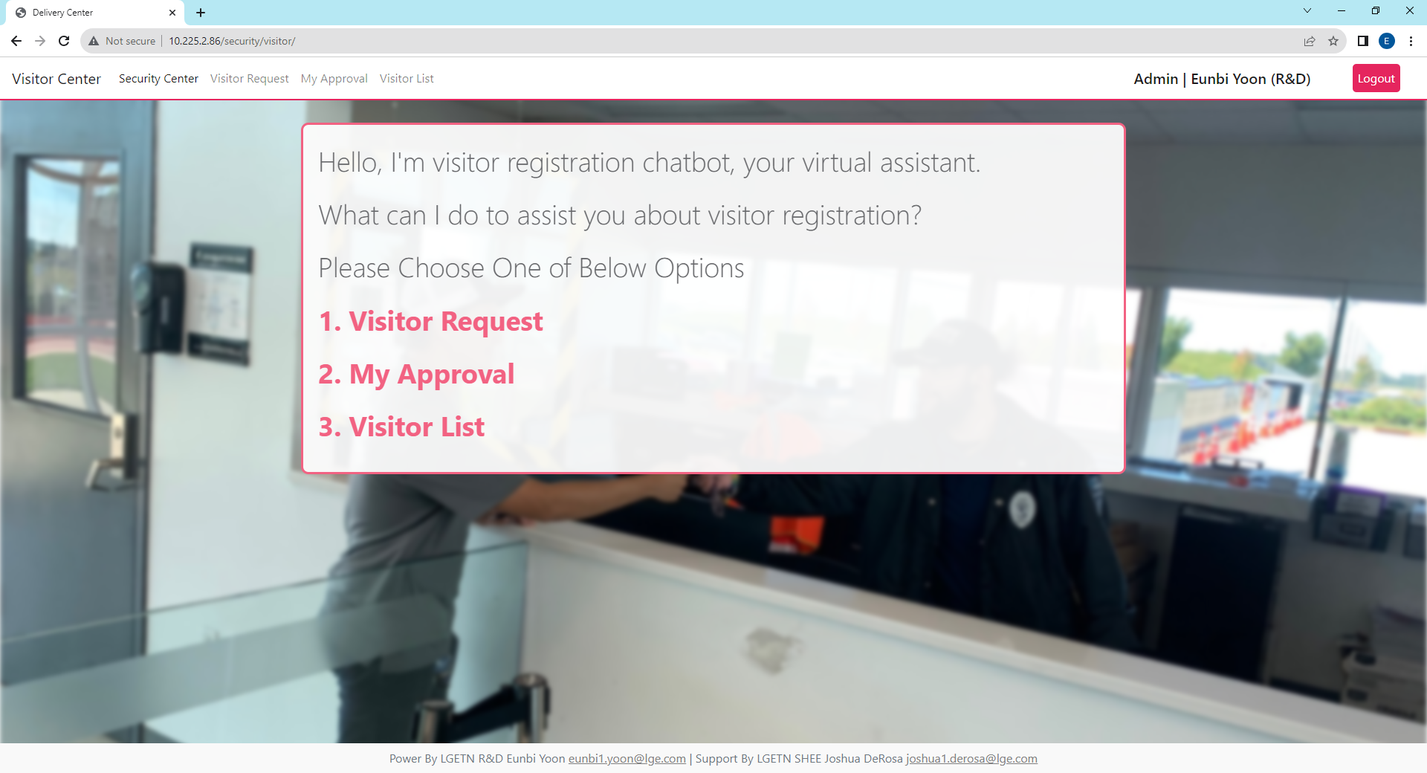
2. Visitor Portal - Main
When you have visitor, you can use this portal to request visitor and get approval from security admin.
Regarding to company rules, even you get approval in here, when visitors move their locations visitor PIC should be with visitors all the time.
The main page is operating like chatbot so if you want to move to your request fast please use quick menu located on the top of all web pages.
If you want to go back to main page click the security center
Quick Menu
Users Request Visiting Non-LGETN Member
Users Check their Visitor Request Approval. All Users need Security Admin Approval about their requests
When Visitor come in and out Security Gate,
Security Admin will check-in and check-out

Slide 8
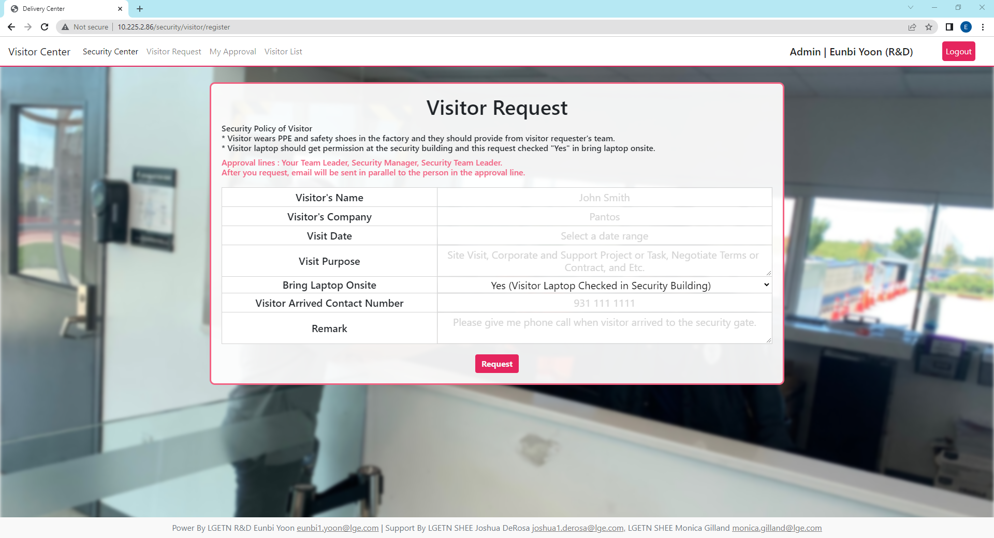

2. Visitor Portal - Visitor Request
All blank is required to fill, except remark section. Each blank example shows as placeholder so please refer to those.
You can register several visitor in one request and please describe each blanks as much as detailed.
If visitors bring laptop, they should download LGETN security program in the security building before access to the building.
If you remained your contact number, then security will try to call you when the visitor arrived in security building.
Example : Placeholder

Slide 9
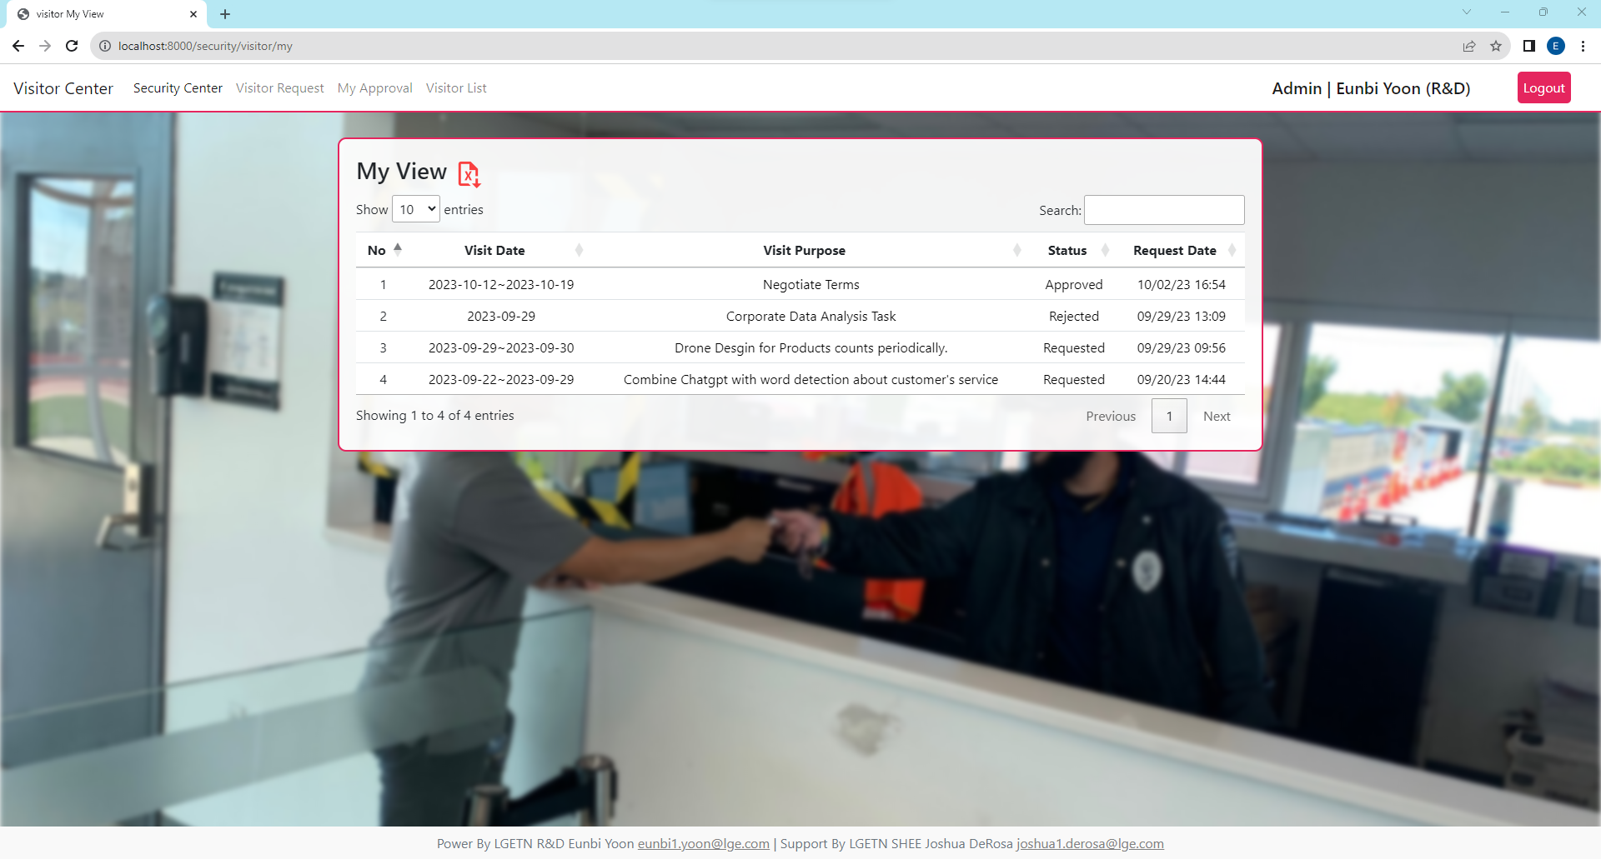
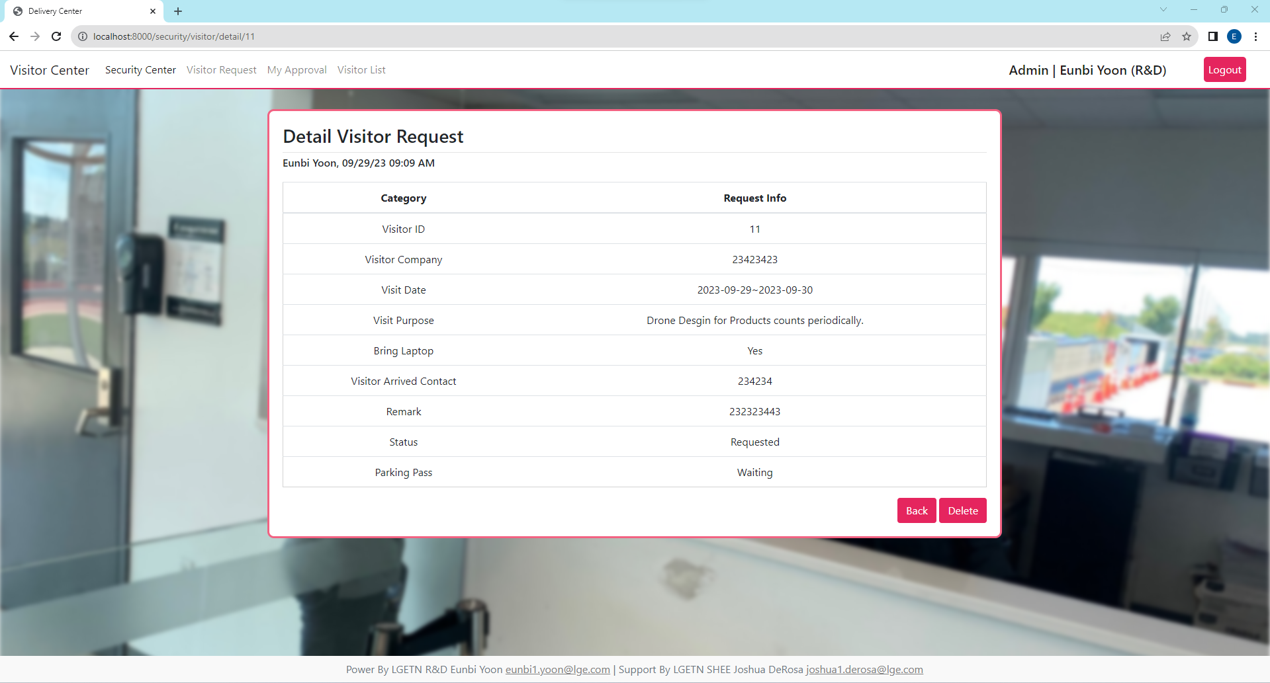
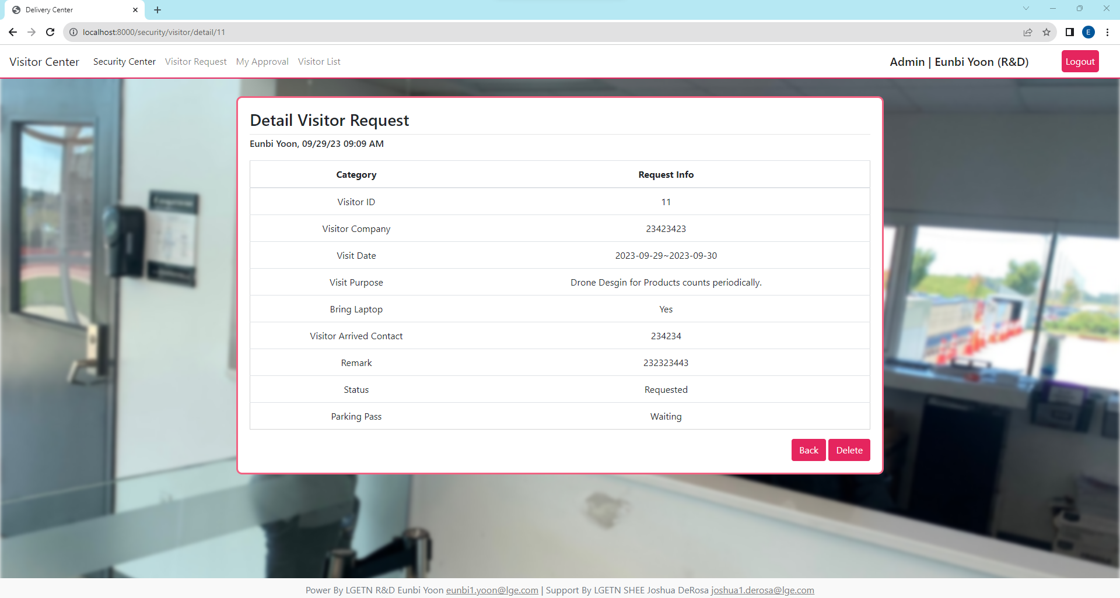

2. Visitor Portal – My Approval, Detail View
When you hover, it display column with pink color then you can go to detail view.
In the detail view, you can go back or delete your request and see all detailed about your request.
If the security admin did not approve, then your request status will be “Requested” and you cannot print out parking pass.
My Approval
Detail View – Requested Status
Detail View – Rejected Status
Detail View – Approved Status

Slide 10
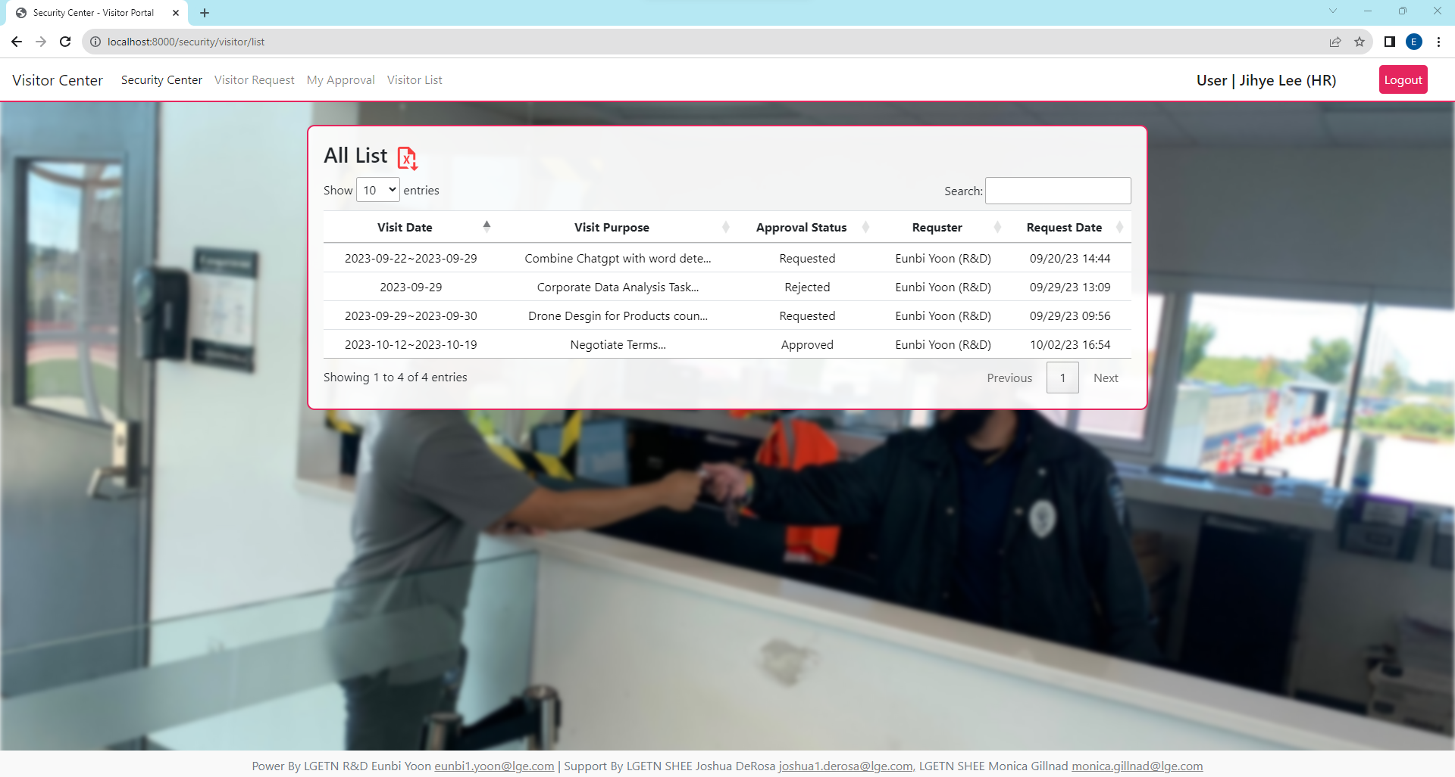
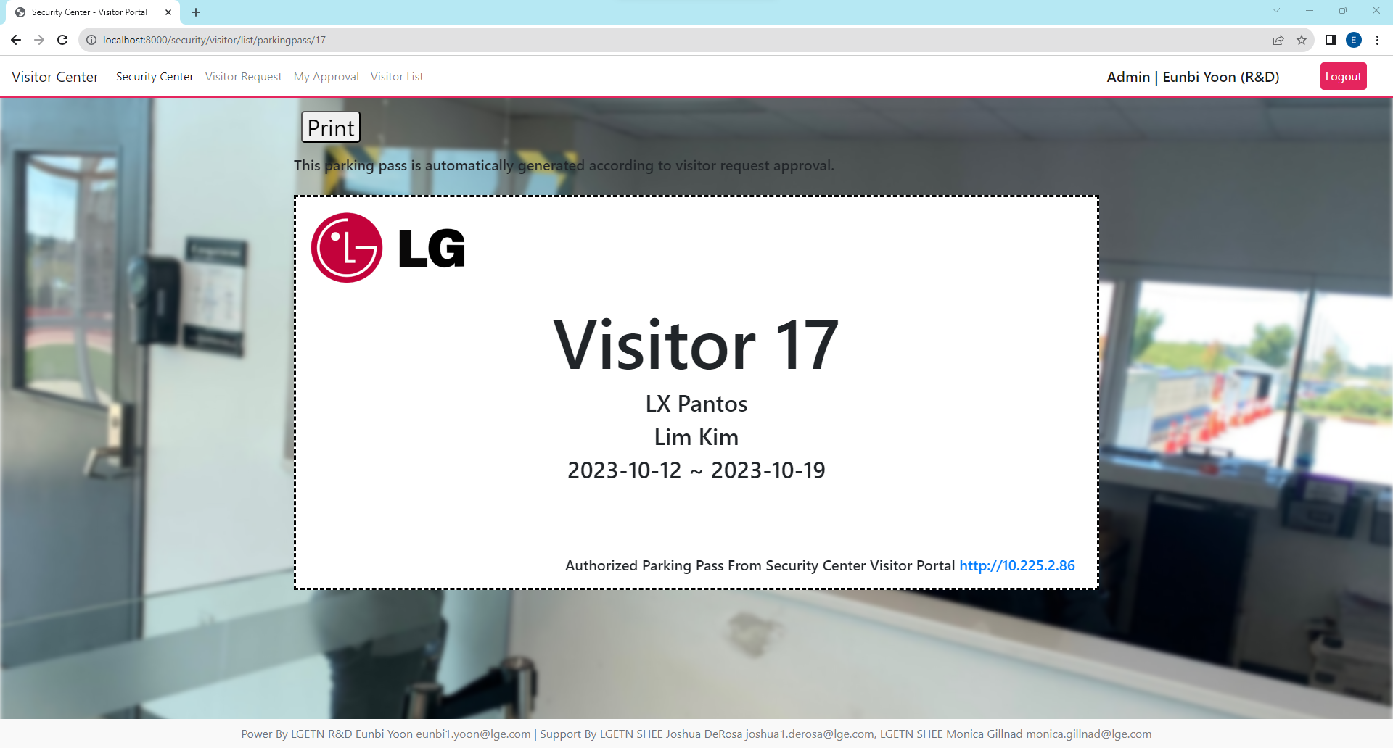
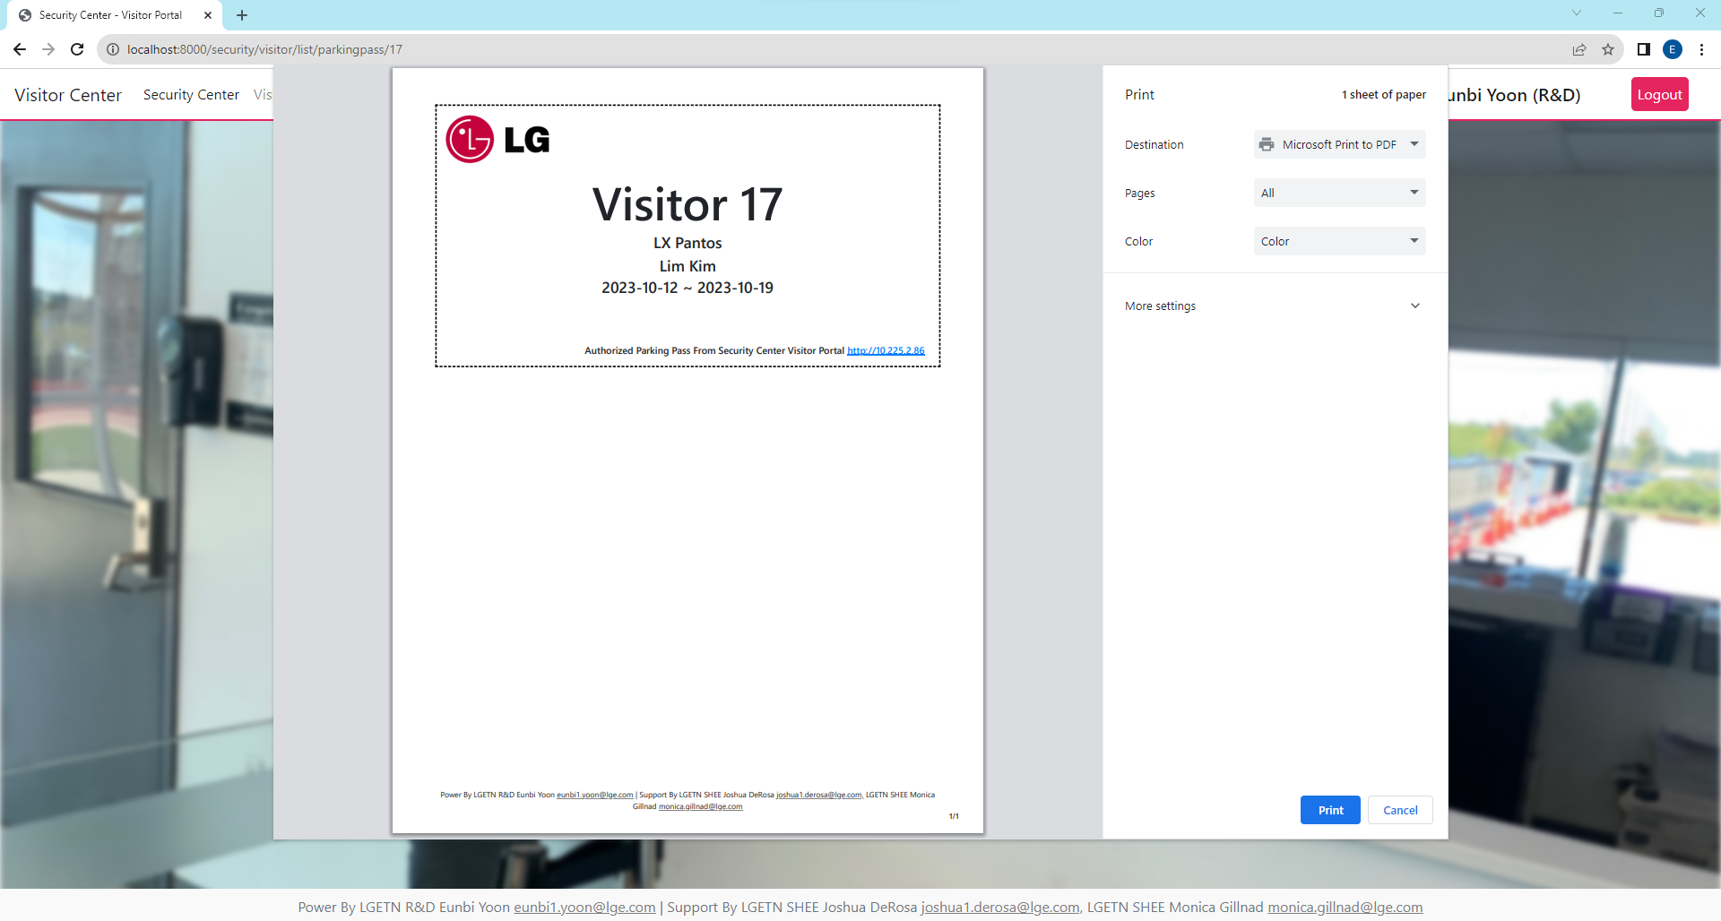
2. Visitor Portal – Visitor List
Only admin or manager authority can see check “approve” column and please refer to the difference between user and admin/manager accounts.
If the admin approve your request, you can print parking pass. Once admin decided approve or rejected, you can change your decision in admin dashboard.
List View – Admin or Manager Account
List View – User Account
Approve
Check Button
Parking Pass,
Security In, Out Active
Admin
Reject
Delete(X) Button
Delete Request
Parking Pass
This is Parking Pass and press button for print.
User or Admin can provide parking pass to visitor
*Visitor should put parking pass at windshield.
Parking Pass has following information
Visitor ID, Visitor Company, Visitor Name, Duration Stay

Slide 11
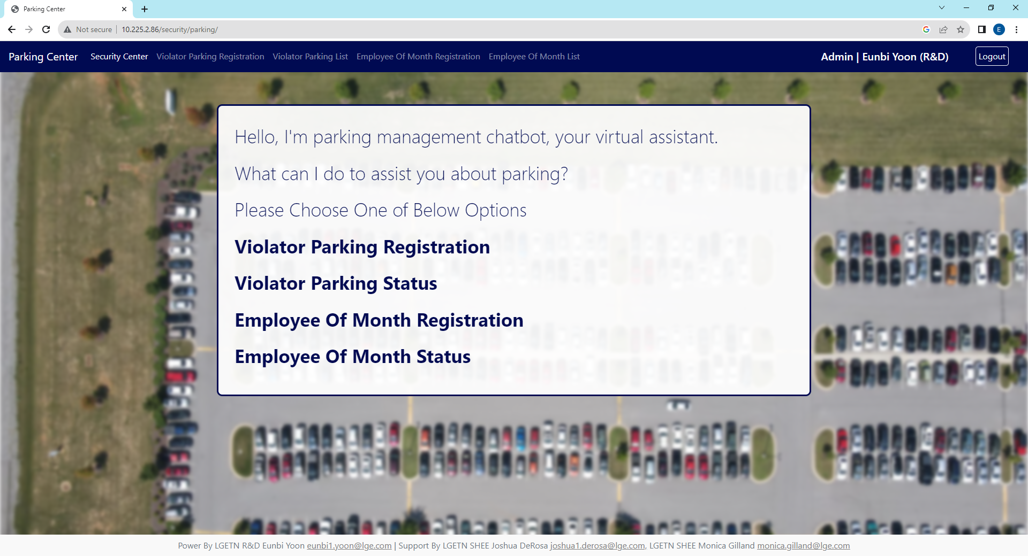
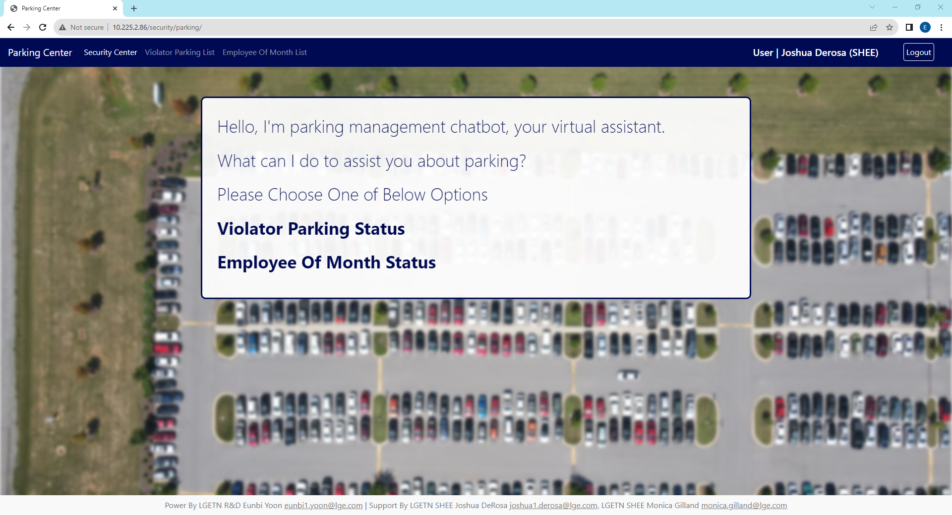
3. Parking Portal – Main
Manage 3 different parking space (visitor, gate2 and VIP parking) with register violator and employee of months.
It has a close relationship with visitor portal because when you register visitor then you will get parking pass also.
User accounts cannot access to register violator parking or employee of month and admin will register those platform.
The purpose of this parking tracking is to clarify authority to access to parking in LGETN.
Parking Portal Home
Security Center Home
Admin, Manager View
Quick Menu
Quick Menu
And Home Menu
Have Same Link
Parking Violator Registration with counting function
Review violator registration and claim if you want.
Employee Of month assigned special parking space
Check Employee of Month Status for visitor parking
User View
User can only review the status.
Register is in charge of Admin

Slide 12
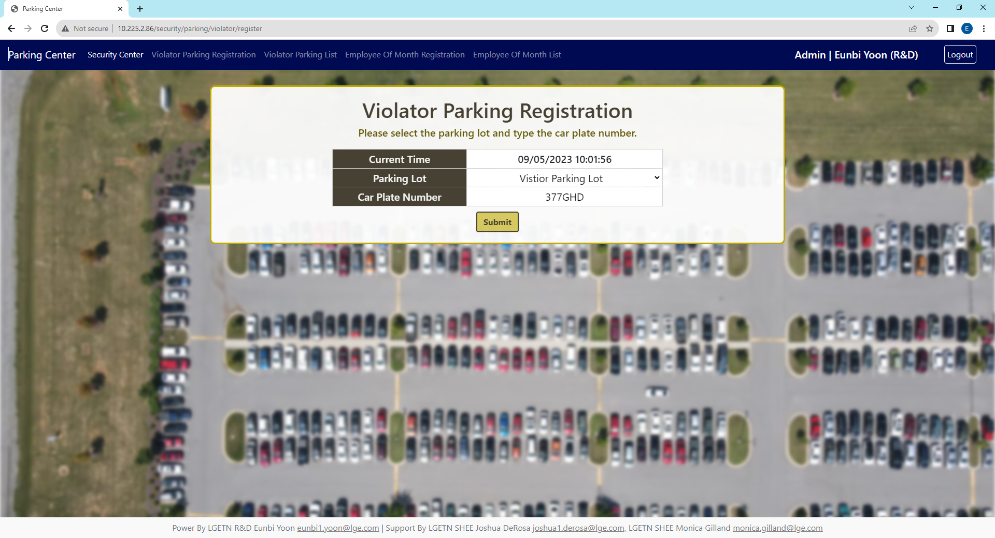
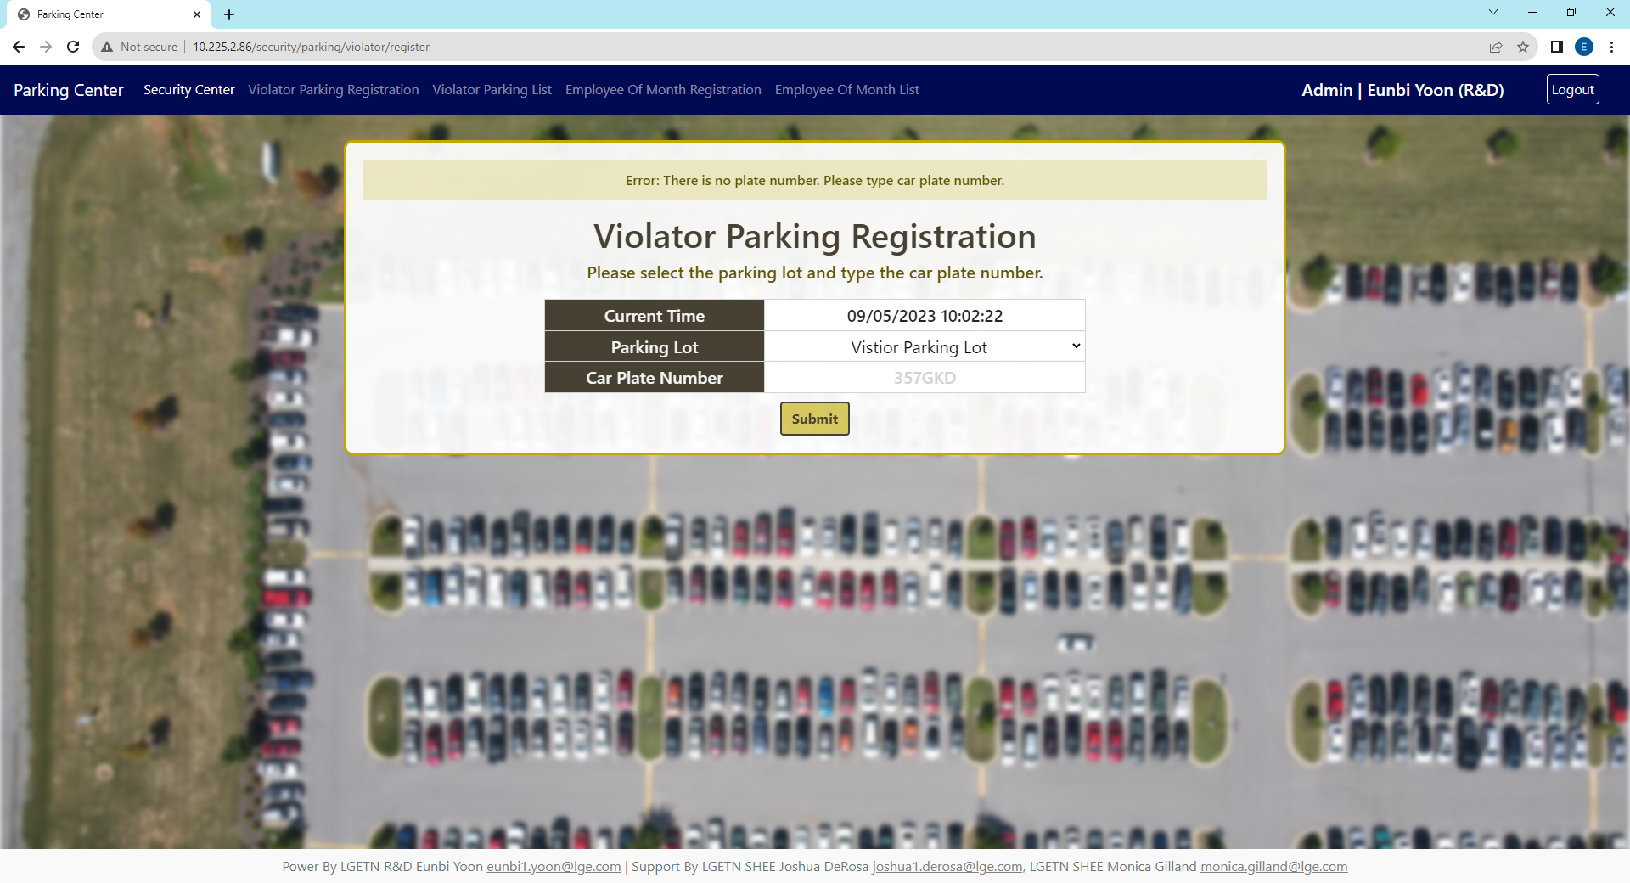
3. Parking Portal – Violator Registration
Violator’s car registration is in charge of main security building guards therefore user cannot access this page.
Choose parking lot and input the car plate number to register violator’s car. Current Time is not based on USA CDT time zone.
Parking lot have three options as visitor, gate2, and VIP parking lot and type car plate number. Both information is required to register.
After request registration, it directly link to violator parking list section and this request does not require any approval.
Admin, Manager View
Show Current Time, Do not have to type here
Click to see select menu for parking location
Type Car Plate Number
Error Message
If there is no car plate number and you click to submit, it will not register and show you error message
Error Handling:
Even though you put any spacebar between car plate number, it will recognize error and save in the database without blank.

Slide 13
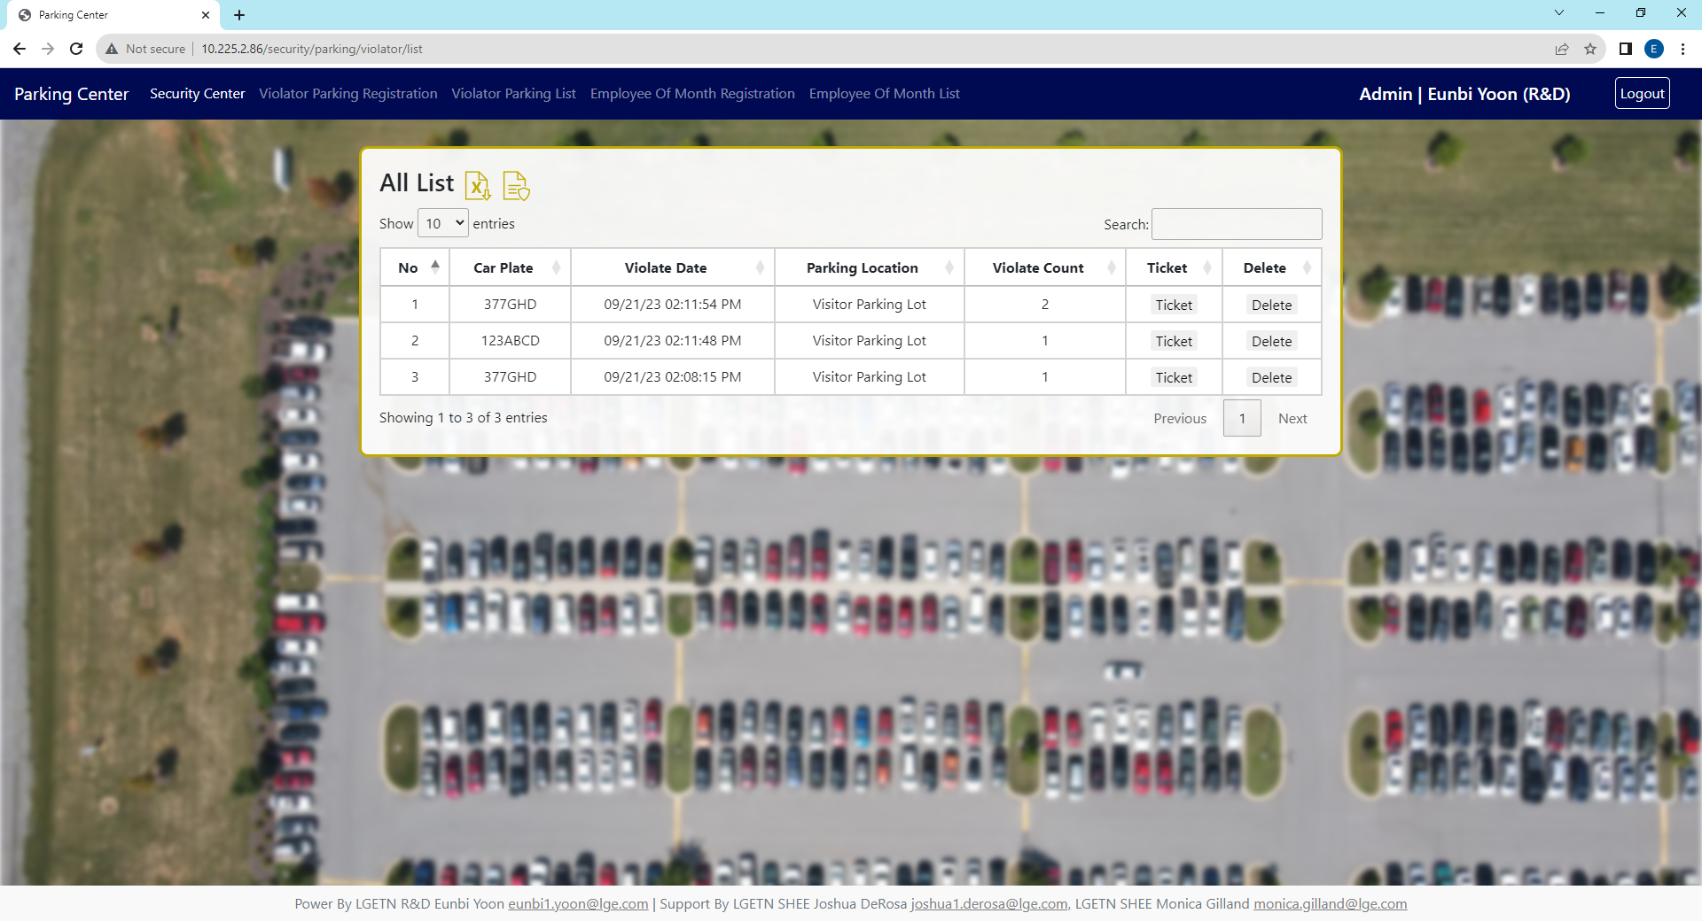



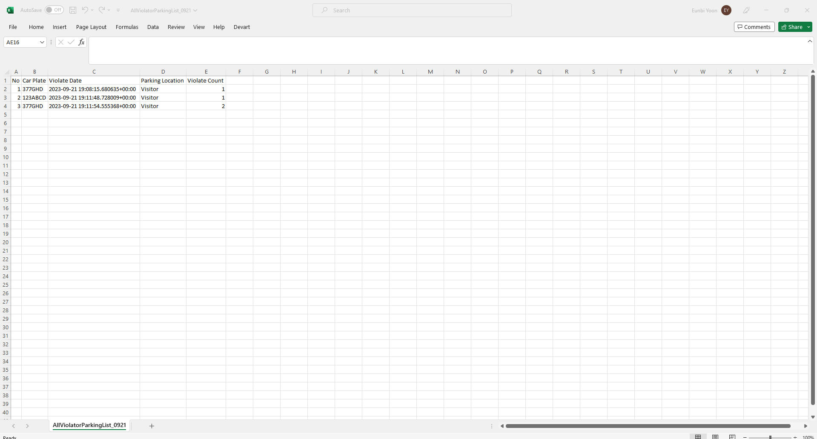
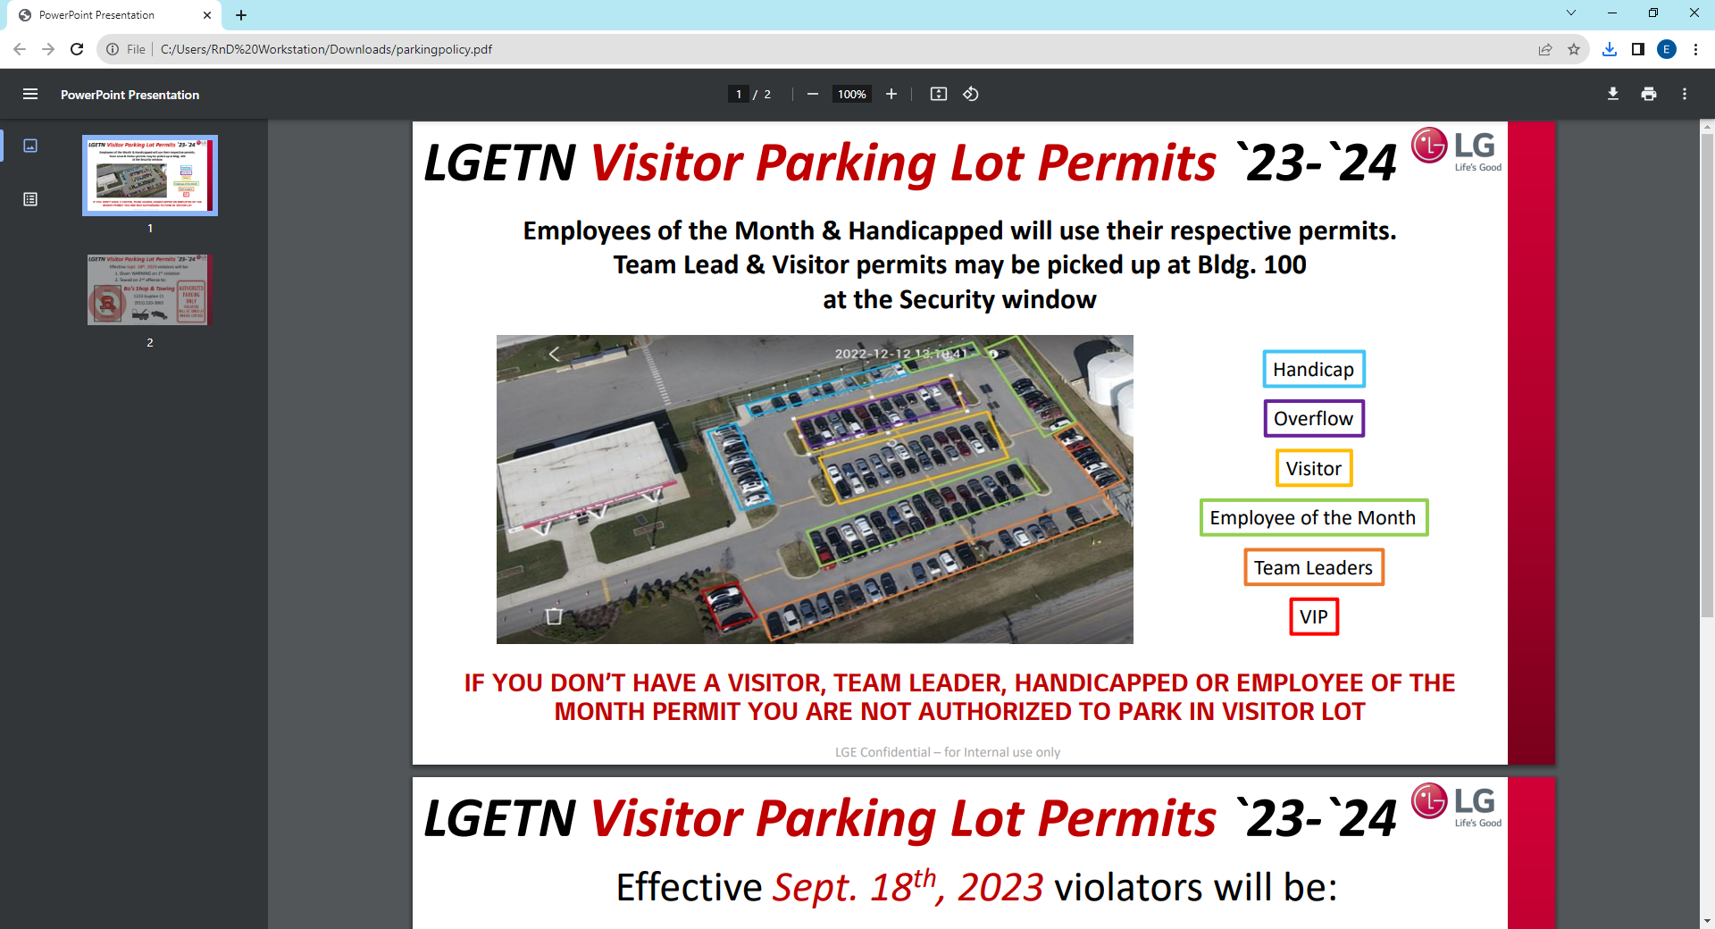
3. Parking Portal – Violator List
When you register the violate information on website, database counts how much the car violate the rule.
If you register data incorrectly, please go to the list and delete the most recent database, check the count and delete highest count database.
In violator list view, data sorted by most recent registered date and you can adjust how many data rows in one page and move page to see next data.
Search
When you type something in search section, it will search the keyword in all columns.
The easy way to find your history is searching your car plate number or date.
Delete (Only Manager, Admin)
Delete Not Display in User
Select How Many Data in one page
Click to see next page.
Depends on how many rows in page, total page count will change
Excel Download
Security Policy Download
Excel File Name : “AllViolatorParkingList_(today date)”
If nothing is happen after you press this button,
then please check download folder.

Slide 14

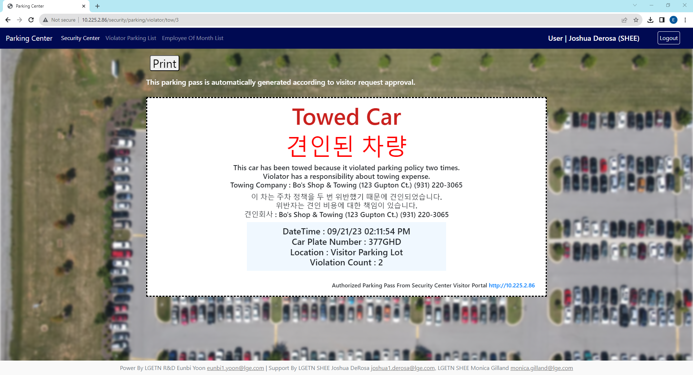
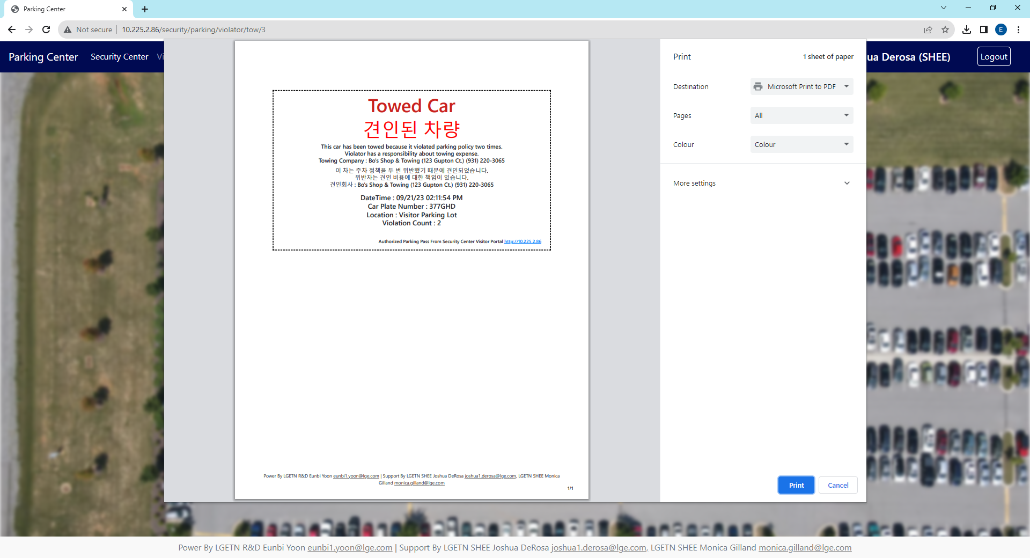
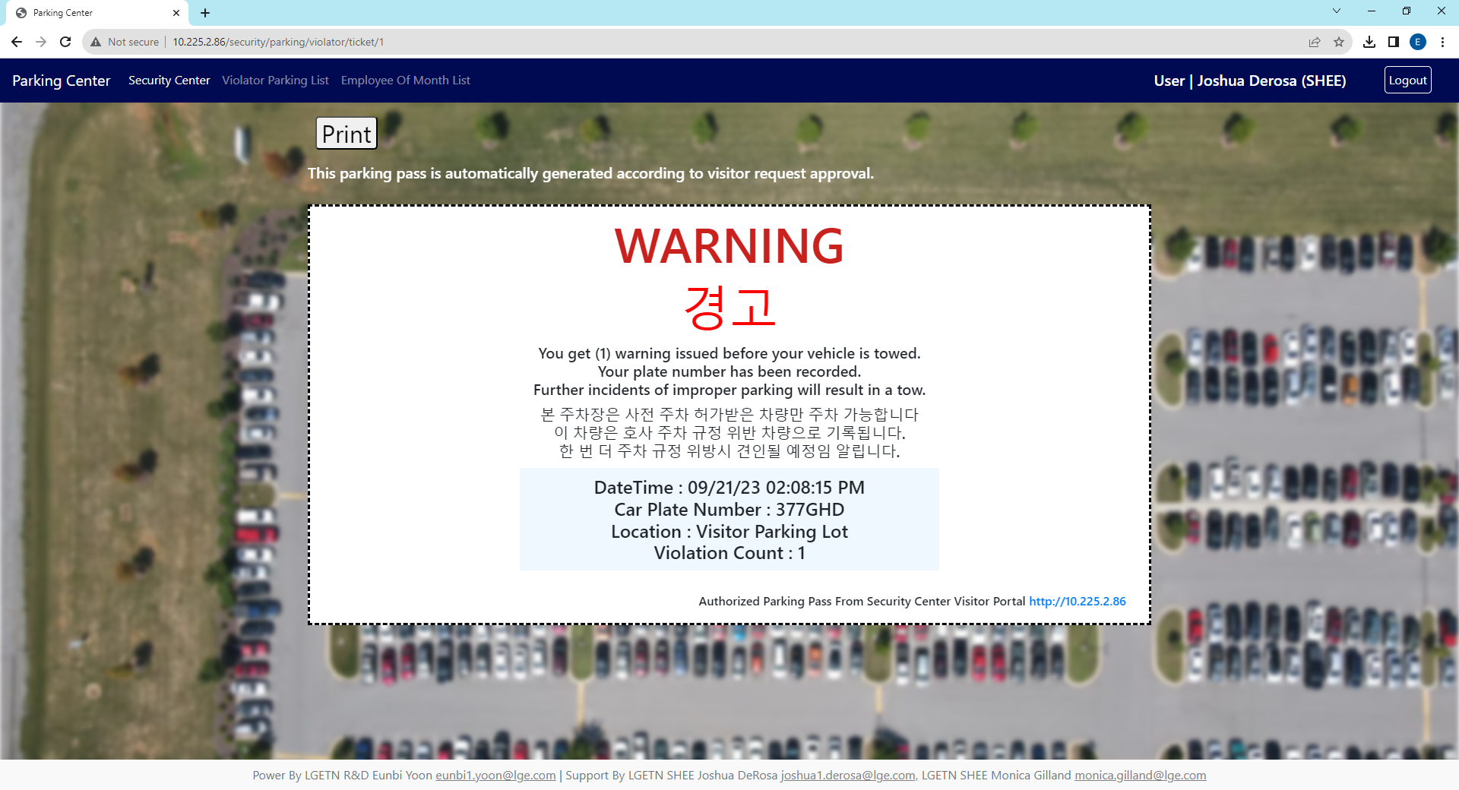
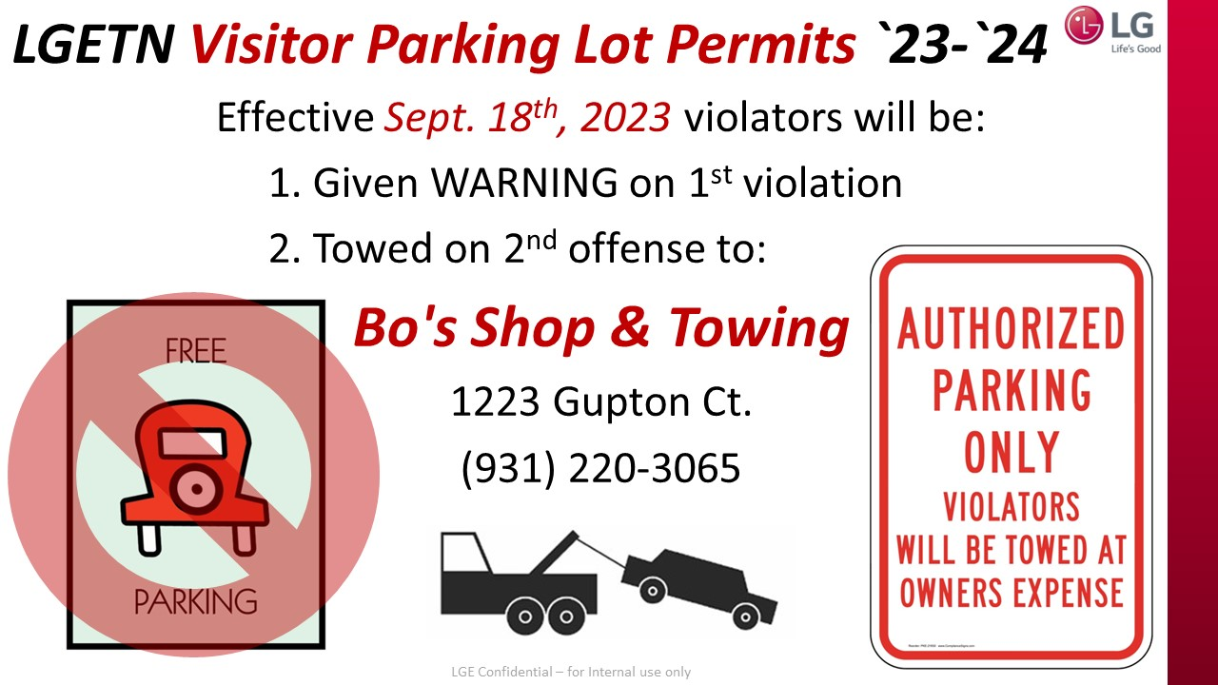
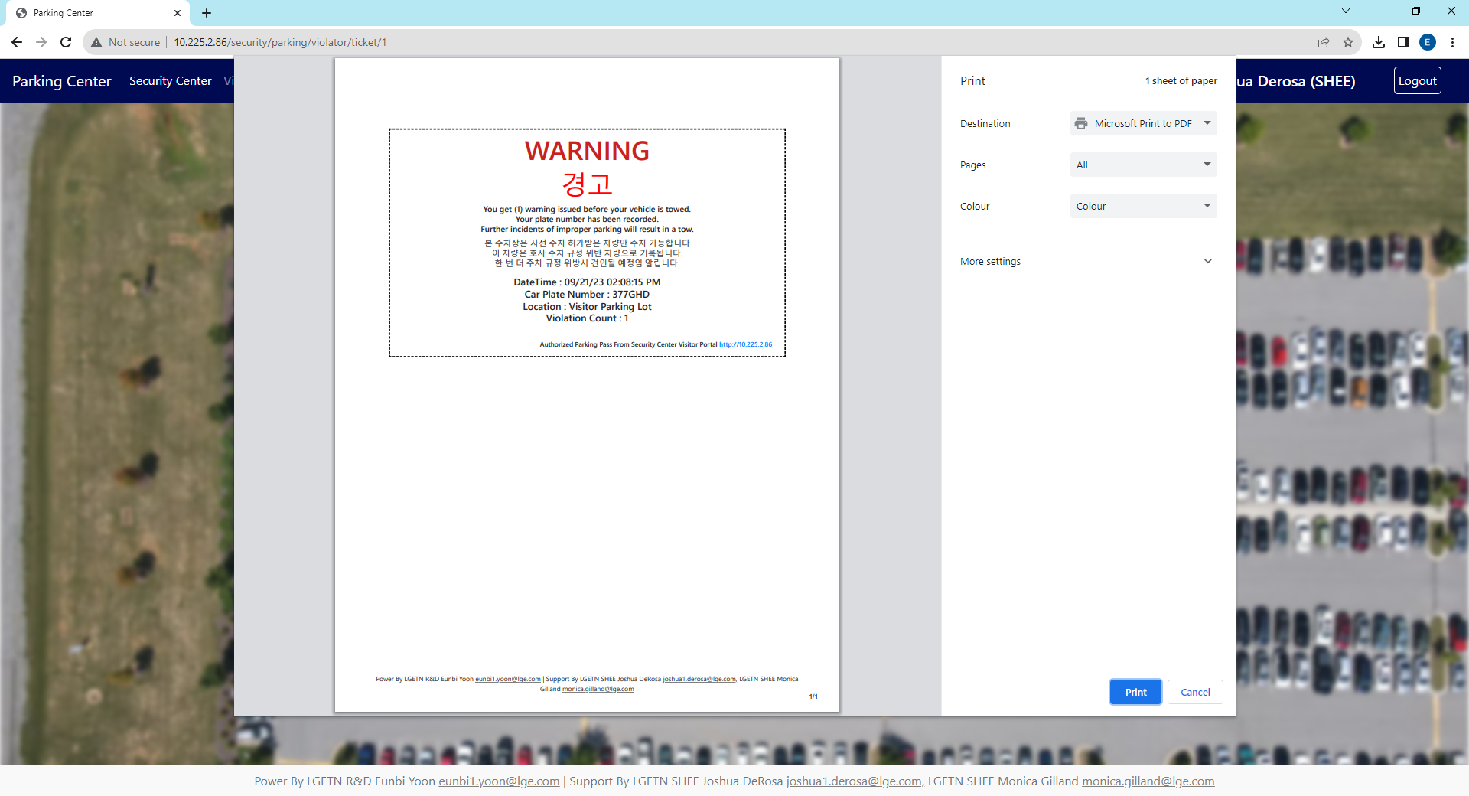
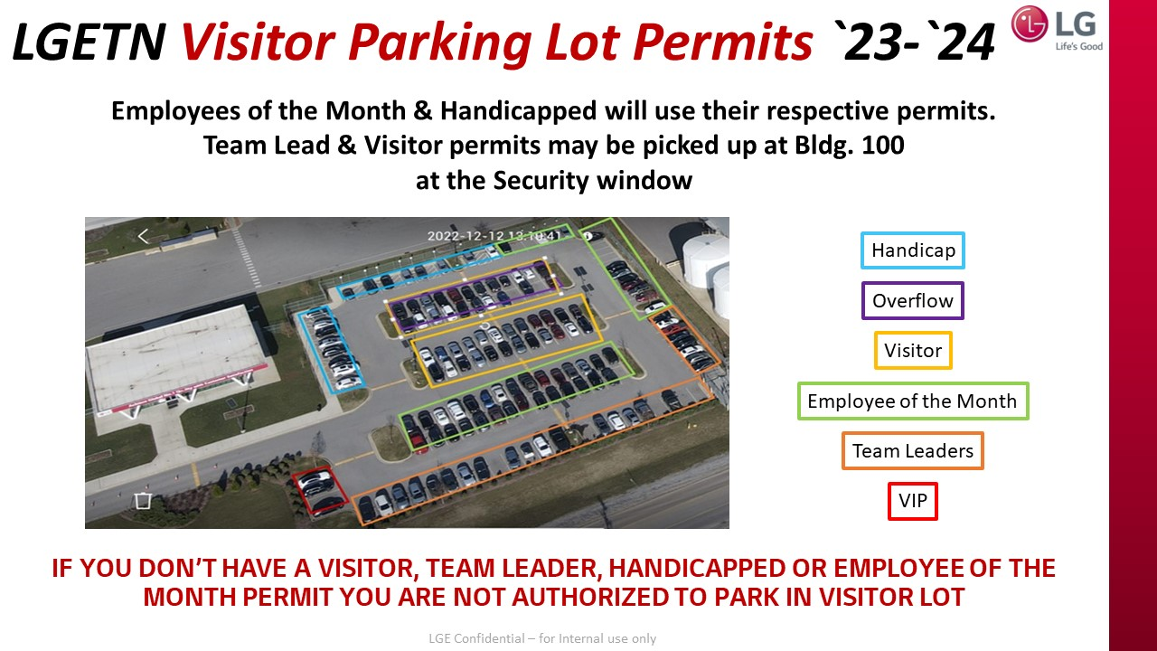
3. Parking Portal – Violator Ticket
Admin or manager can click the ticket button and print out to copy. First violate and second violator ticket are different.
According to security policy, when violate 2 times, violator’s car will be towed at owners expense and please contact to Bo’s Shop & Towing about this issue.
Ticket
2nd Violate Ticket
1st Violate Ticket
Security Policy
Click to Print

Slide 15
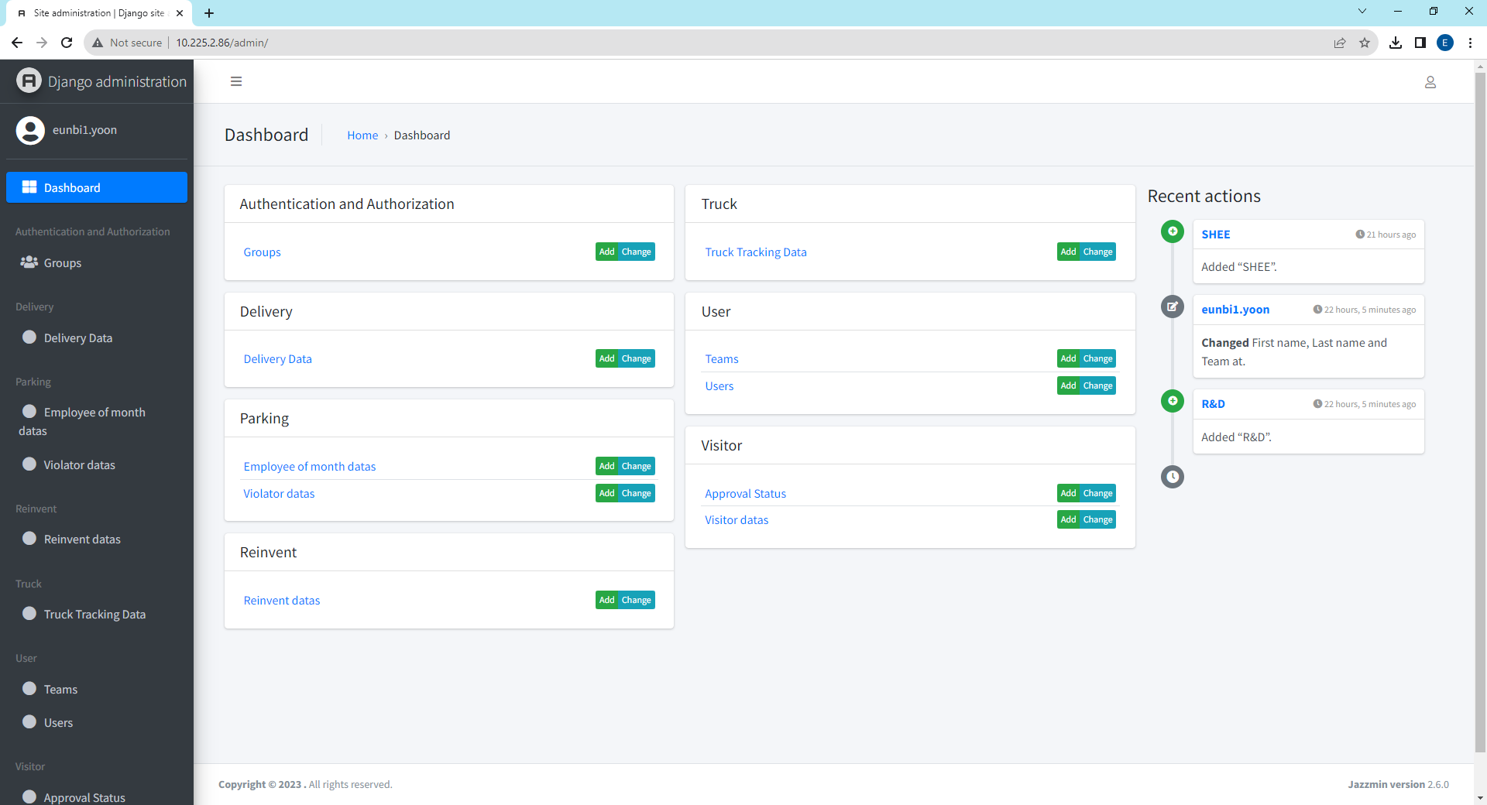
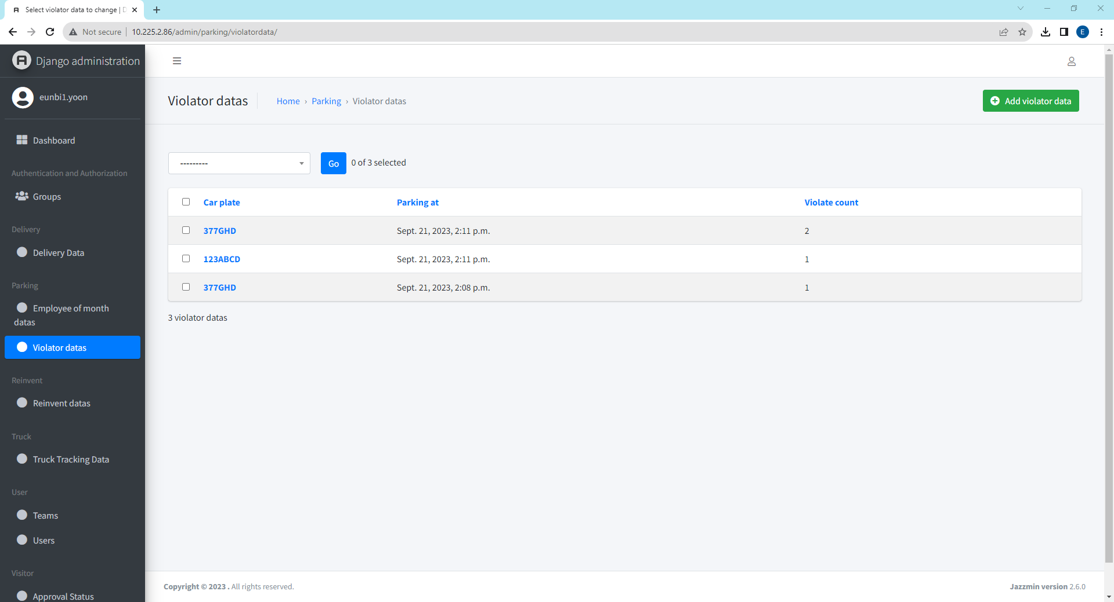
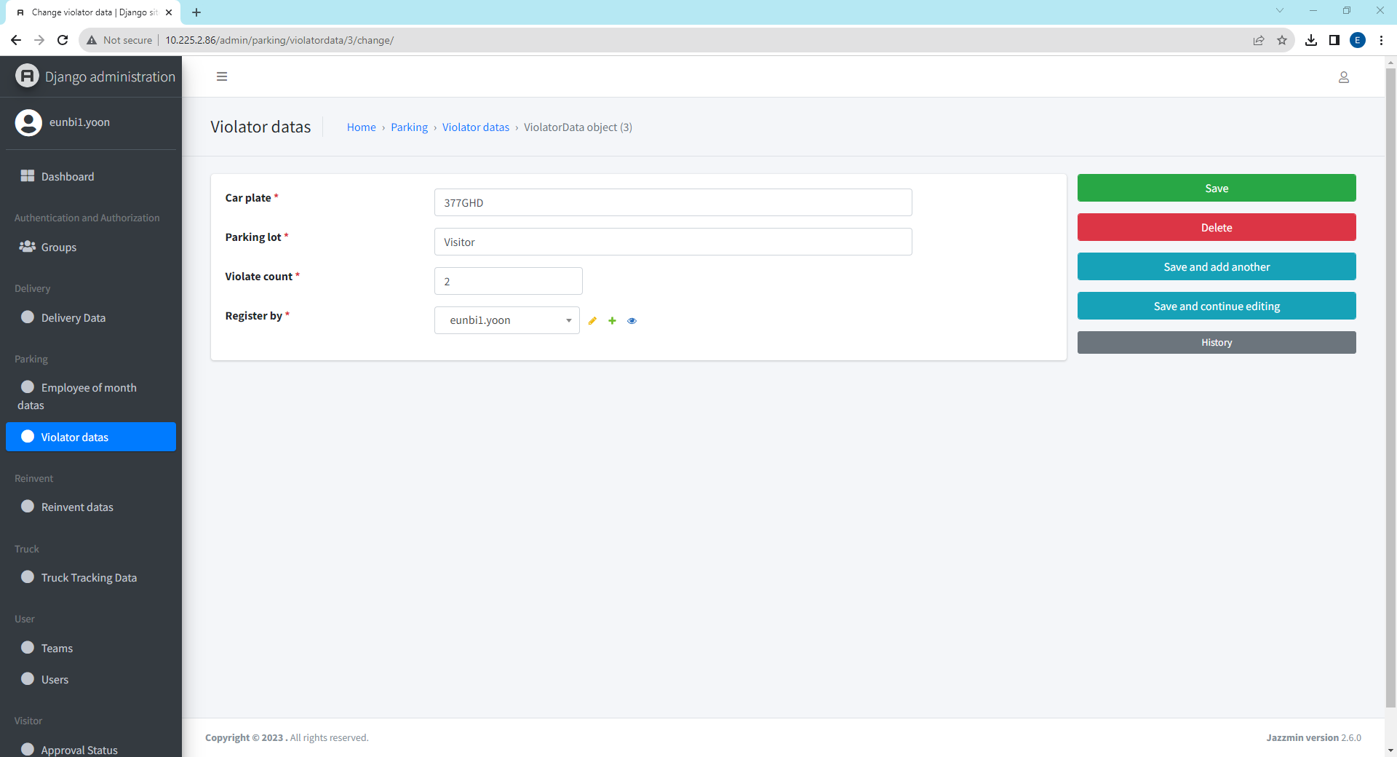
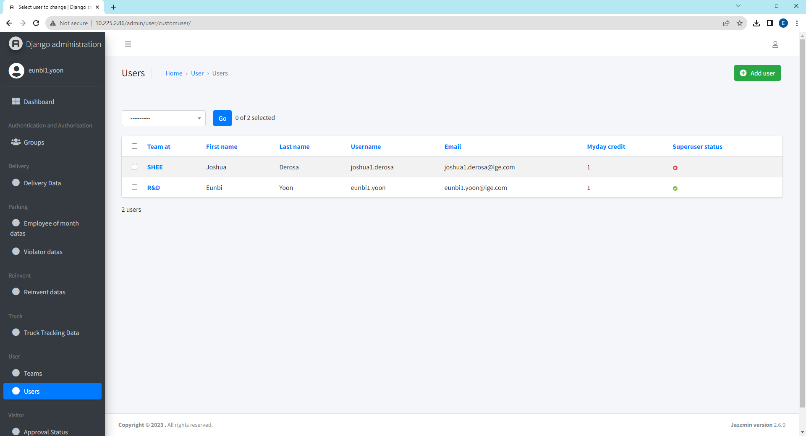
3. Parking Portal - Violator data registered PIC
This function is only available from Admin or manager account.
Please access to below website to go to admin dashboard http://10.225.2.86/admin.
1. Click violator data
2. Click data for detailed review
3. Check “Register by” Section
4. Detailed User Information
Find matching username with “Register by”
Click this to see detailed information of user
Click User

Slide 16
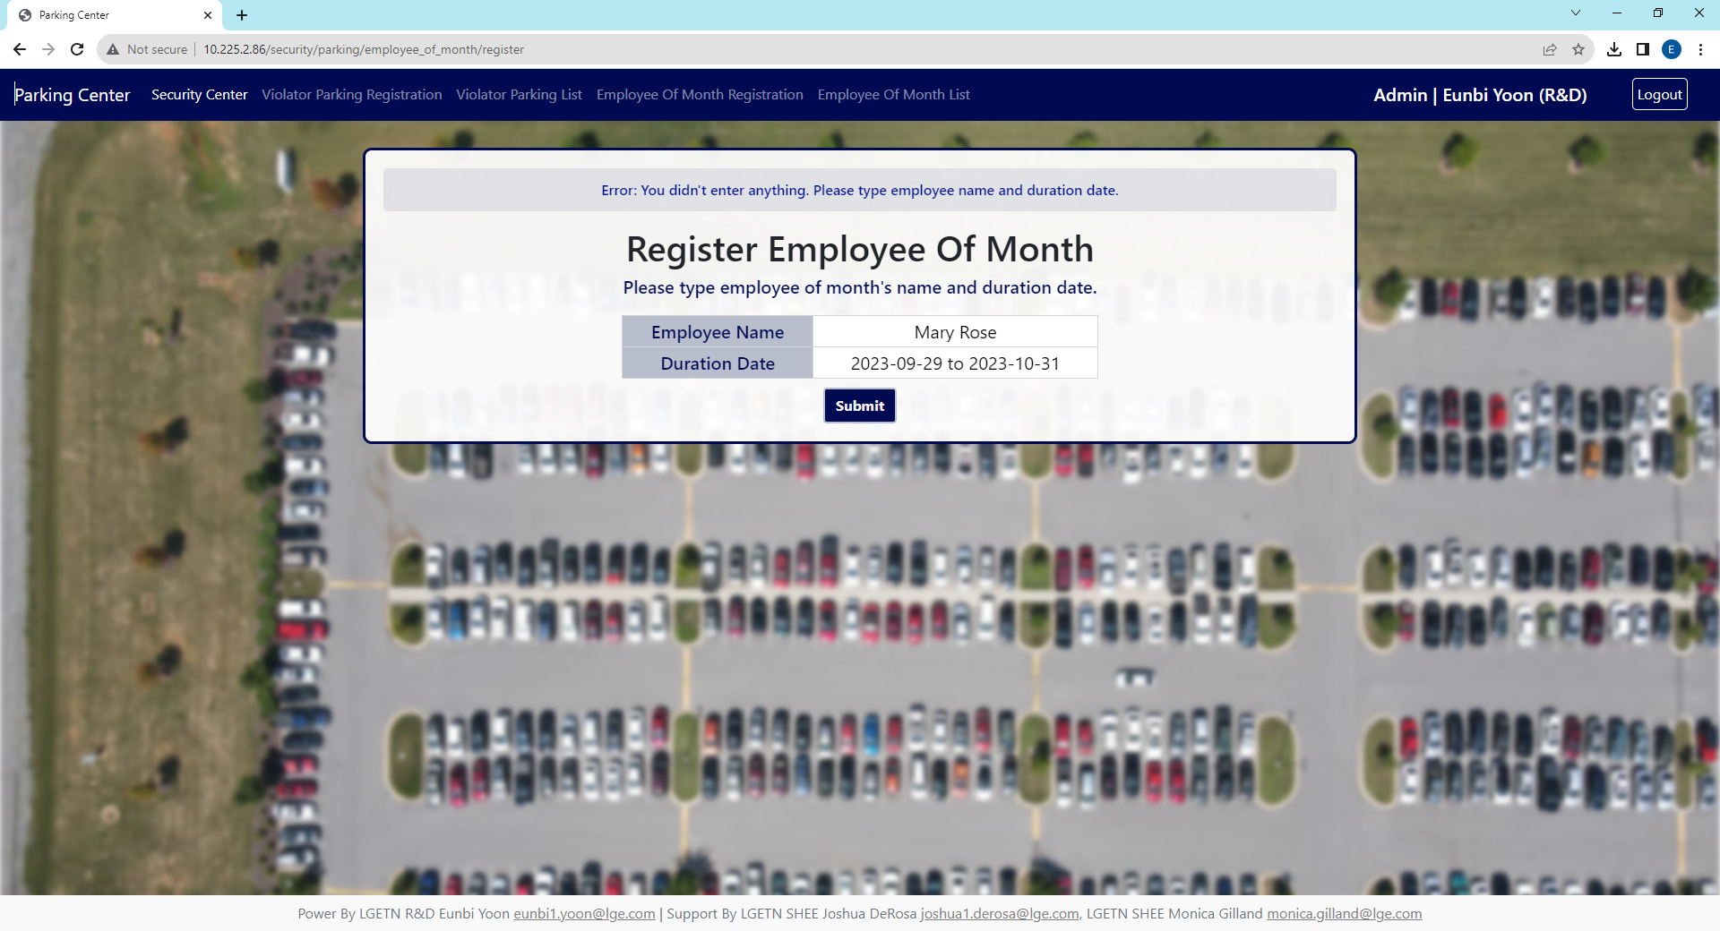



3. Parking Portal – Employee Of Month Register
According to security policy, employee of month has authority to park in visitor’s parking lot in particularly section displayed parking sign as “Employee of Month”.
Every month, security manager will register employee of month list because manager and admin authority can access this page but user cannot access this page.
Admin, Manager View
Error 1 : No Duration Date & No Employee Name
Type Duration Date & Employee Name and hit “Submit” Button again
Error 2 : No Employee Name
Error 3 : No Duration Date
Type Employee Name
and hit “Submit” Button again
Type Duration Date
and hit “Submit” Button again

Slide 17


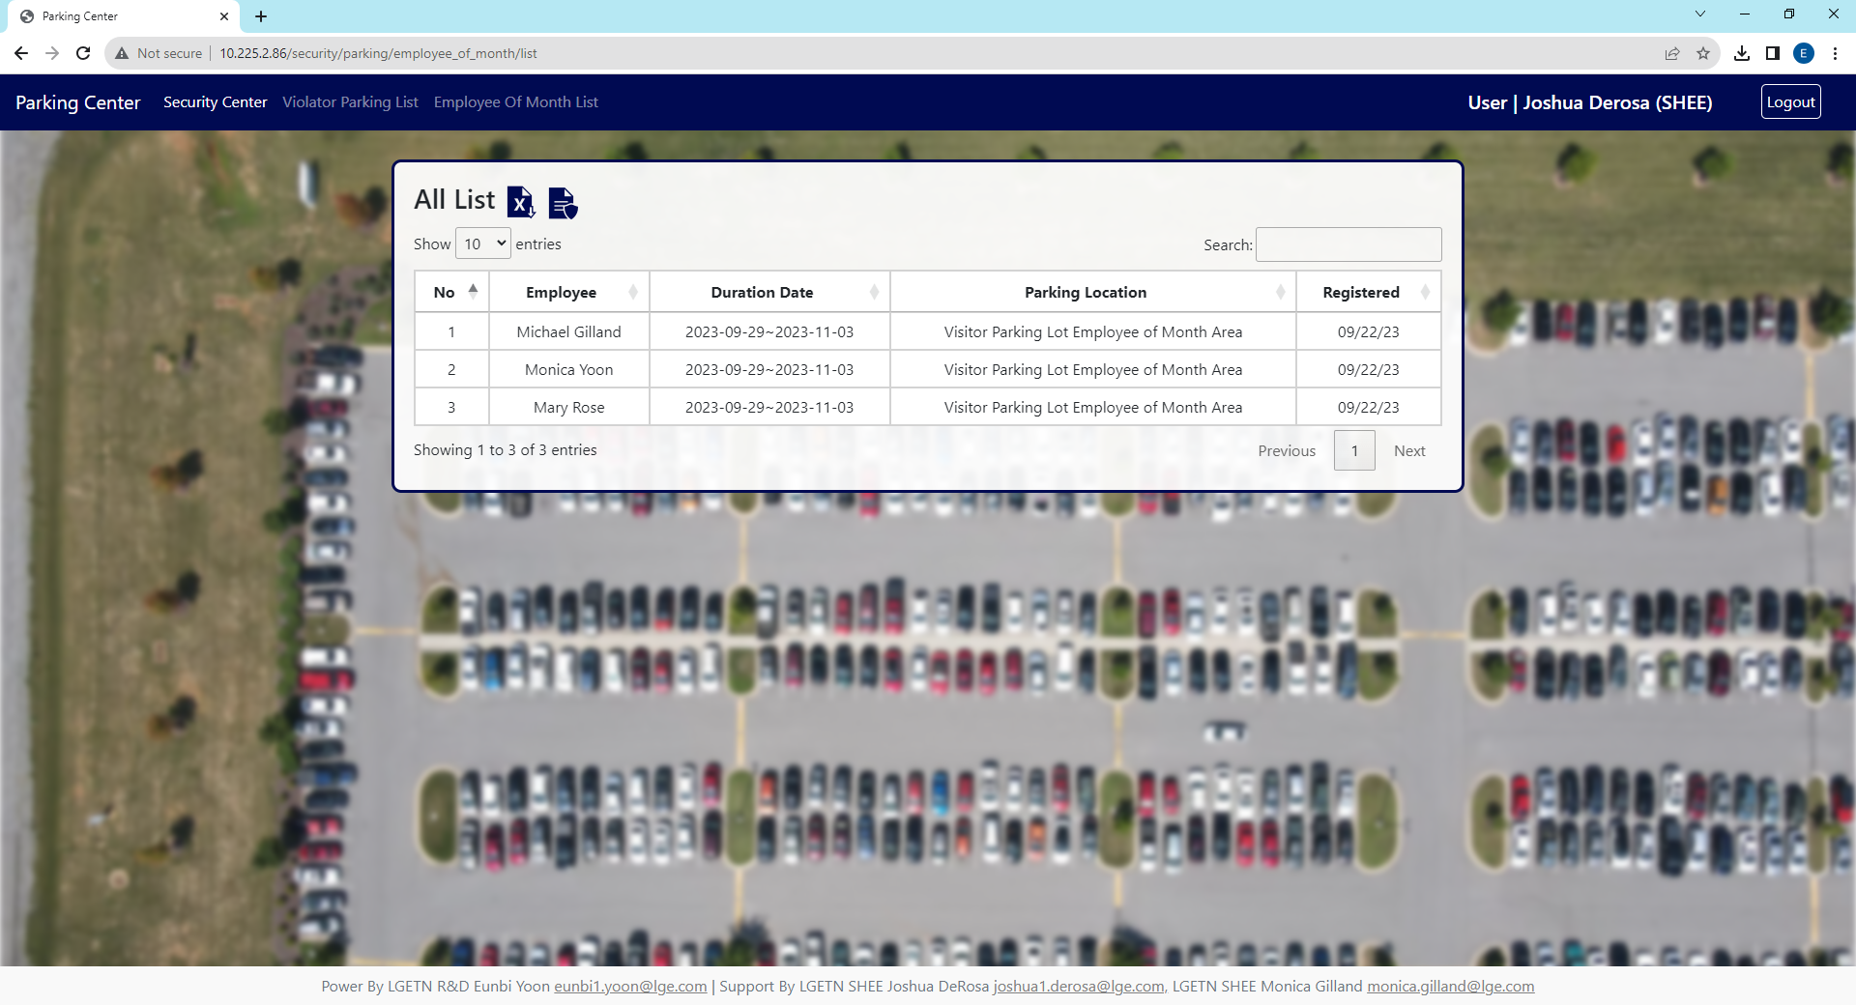
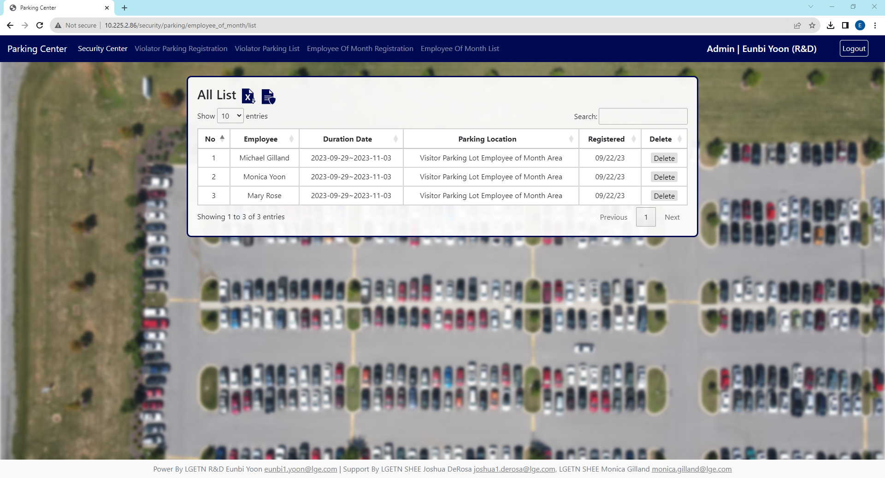
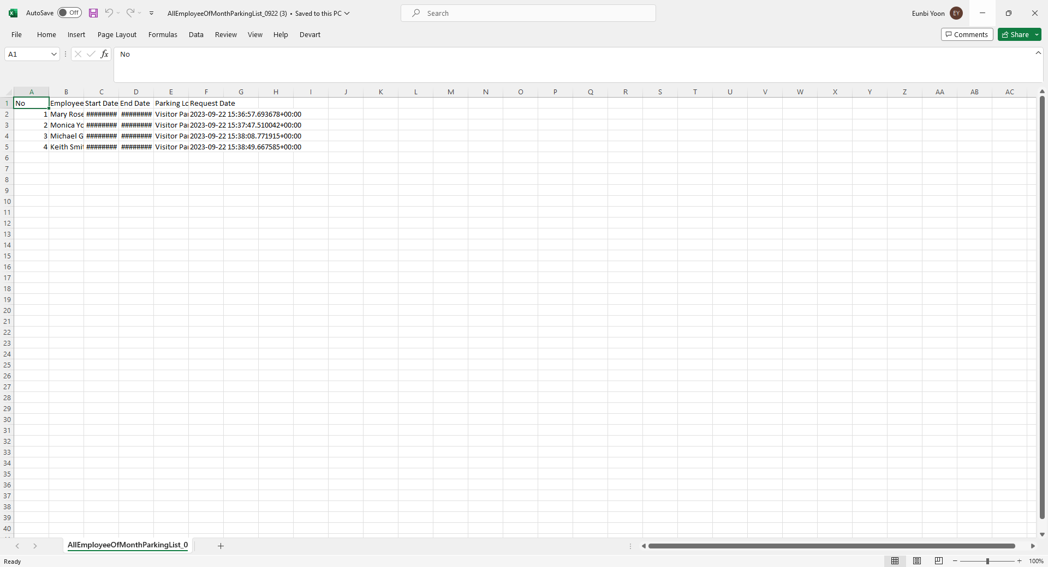
3. Parking Portal – Employee Of Month List
If you are employee of month, visit this page and check your name is in here and if your name is not registered in here then please contact to below.
In employee of month list view, data sorted by most recent registered date and you can adjust how many data rows in one page and move page to see next data
Search
When you type something in search section, it will search the keyword in all columns.
The easy way to find your history is searching your car plate number or date.
Delete (Only Manager, Admin)
Delete Not Display in User
Select How Many Data in one page
Click to see next page.
Depends on how many rows in page, total page count will change
Excel Download
Security Policy Download
Excel File Name : “AllEmployeeOfMonthParkingList_(today date)”
If nothing is happen after you press this button,
then please check download folder.

Slide 18
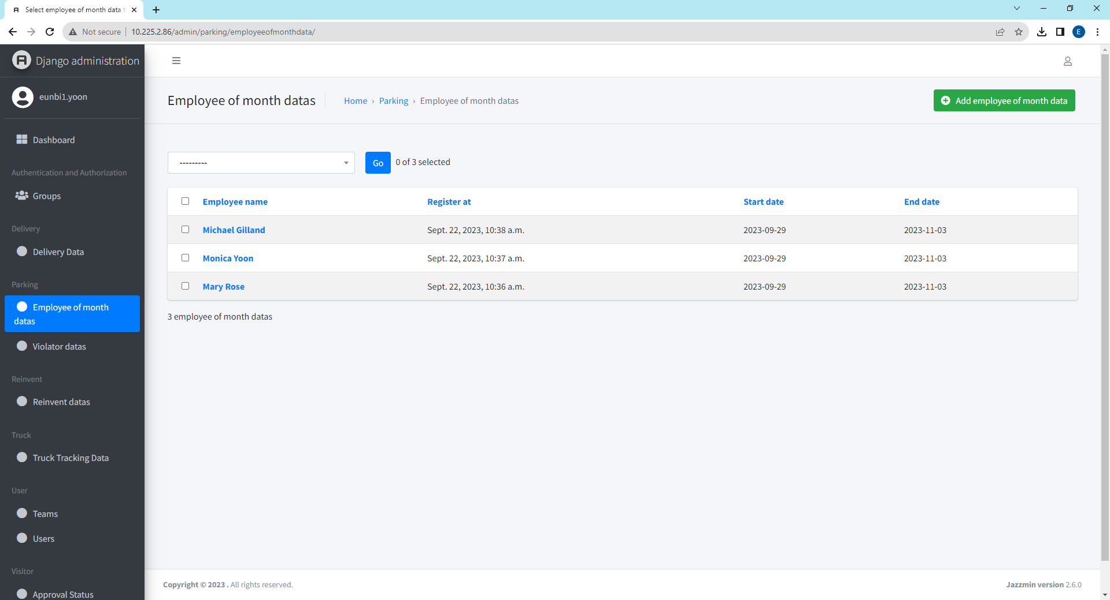
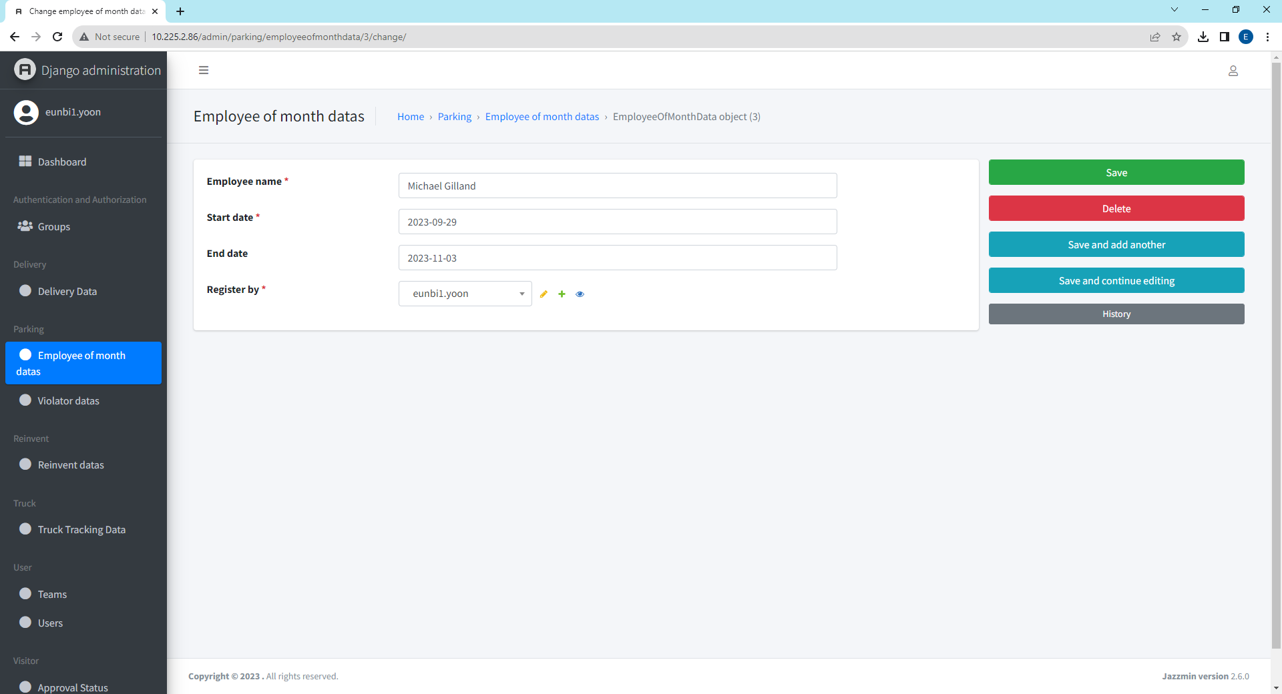
3. Parking Portal – Employee of month data registered PIC
This function is only available from Admin or manager account.
Please access to below website to go to admin dashboard http://10.225.2.86/admin.
1. Click violator data
2. Click data for detailed review
3. Check “Register by” Section
4. Detailed User Information
Find matching username with “Register by”
Click this to see detailed information of user
Click User

Slide 19


4. Truck Portal - Main
When truck is in and out Gate2, the history will track in this page and user(material, SCM, LX Pantos, etc) can access this page to review truck tracing.
Check-In and Out is in charge of security manager, therefore user can only access to review history.
Admin, Manager View
When truck is arrived in Gate2, security admin works on check-In
When truck tried to out of LG,
Find check-In result and click checkout button
User View
User account is only able to access review history

Slide 20




4. Truck Portal - Check In
Type the information about check-in and all requirements came from manual sheet as below. After submit, it move to history page.
All fields are required and if there is a blank, then it will give you error message remarked blank is empty. Fill out those blanks and submit again.
Check In System
Manual Excel Sheet
Error Message
Error Message Pop Up when you miss to fill out one of category. It shows which category is missing therefore please fill out those blank and try to resubmit again

Slide 21




4. Truck Portal - History
After check-in, it moves you to all history of truck in and out and download with excel file. Delete function is only available to admin and manager accounts.
To checkout, search the truck information and click View button. Check-In PIC and Check-Out PIC does not have to match.
History
Search Function
Download Excel File
Go to Detailed View
Excel File name is “TruckTrackingList_(today date).xlsx”. If you cannot find it, please check your download folder
This is “Check In” status, therefore there is no information about checkout

Slide 22




4. Truck Portal - User’s Detailed View After Check-In
If you are check in PIC, then you can see edit and delete button. Checkout PIC doesn’t have to match with check in PIC.
Check detailed information about truck, then you can click the checkout button. User can only see “Back Button”
Check-In PIC View
Show current status : Check in
Check in : Truck is inside of LG
Check out: Truck is outside of LG
Not Check-In PIC but Admin or Manager Account
All Functions are available
Checkout, Back Function is available
User Account View
Back to History
Only Back Function is available
When you click “Back” button, it goes to history page

Slide 23



4. Truck Portal - Detailed View After Check-In Function
Truck status is “check in”, check-in PIC can change check-in information except time and check in pic(these two will not change) and same as checkout.
When you hit the delete button then truck all data will delete.
Check Out System
Manual Excel Sheet
Edit View
Delete View
Changeable when check in status
Current information is already filled. If you want to change, change blank and hit the save button
It deleted and connect you to history page

Slide 24




4. Truck Portal - User’s Detailed View After Check-Out
If you are check-in PIC, then you can see edit and delete button. Checkout PIC doesn’t have to match with Checkin PIC.
Check detailed information about truck, then you can click the checkout button. User can only see “Back Button”
Check-Out PIC View
Show current status : Check out
Check in : Truck is inside of LG
Check out: Truck is outside of LG
Not Check-Out PIC but Admin or Manager Account
User Account View
Back to History

Slide 25


4. Truck Portal - Detailed View After Check-Out
Truck status is “Check out”, check out PIC can change check out information except time and checkout pic.
When you hit the delete button then truck all data will delete.
Edit View
Delete View
Changeable when check out status
It deleted and connect you to history page
Current information is already filled. If you want to change, change blank and hit the save button

Slide 26




4. Truck Portal - Update By Manager Account
Go to http://10.225.2.86/admin to access admin dashboard and it could make you login page if you cannot login in here, it means you are User account.
If you need Manager account, please contact by email. eunbi1.yoon@lge.com
Login
Access Admin Dashboard
Click Truck Tracking Data
Click target data id
Change information and click save
This * means that cannot be blank
Click Save to change

Slide 27


5. Delivery Portal - Main
When package arrived in the security building, security admin add new package on the database.
If package has no information in the box, then admin can make QR code and attach but this is optional.
Admin, Manager View
Quick Menu
Back to security center
This is matching
User View
Quick Menu
This is matching

Slide 28




5. Delivery Portal - Add Package(1/2)
To add package, need tracking number and receiver. Tracking number can enter 1) Upload QR or Barcode File 2) Type manually.
This is for 1) Upload QR Image upload tutorial. After tracking number is filed, there is only one option for receiver, receiver should be entered manually,
Tracking Number – QR Image Upload
1
2
Tracking Number : You can only type number in here
3
4
Please type package receiver manually.
When you click save, it is automatically link to search. Check your input is correctly saved

Slide 29




5. Delivery Portal - Add Package(2/2)
This is for 2) Type manually upload tutorial. After tracking number is filed, there is only one option for receiver, receiver should be entered manually.
If you did not put receiver, it will give you an error as below and not able to save. Please type “Unknown”, if there is no receiver information in package.
Tracking Number – Type Manually
1
2
Tracking Number : You can only type number in here
Error – Tracking Number Empty
Error – Receiver Empty

Slide 30




5. Delivery Portal - Generate QR Code
If the package has no information on it, you can generate QR code and save QR code to print out. After QR code is generated, right mouse click to save image.
For tracking number, please type today date and time such as “2023 0920 1011”
1
2
Put cursor close to QR code and right click mouse
3
4
Click the image and print button

Slide 31


5. Delivery Portal - Search View Depends on Account
“Security Checkout” is in charge of security admin check not user or receiver.
Therefore user account cannot see checkout and delete button in search page and admin or manager has both access in this page.
Admin, Manager View
User View

Slide 32





5. Delivery Portal - Search Your Package
These search, copy text, checkout, delete, excel download functions are available in search view. (Checkout function explain detailed in next page)
If user are not going to security building, user can check your package is arrived in security building or not.
1. Copy Text of Tracking number
2. Search
Click this button and it changes to “Copied!” and pasted to check.
Search keyword through all columns, you can type receiver name or arrived date.
3. Download Data as excel file
4. Delete Delivery Data

Slide 33




4. Truck Portal - Security Check Out
When you pick up your package, user need security checkout from security admin, not user. To checkout, tracking number is required.
There is two method to check out your package, access through search or quick menu package checkout. Search view is more easier.
1. “Search” Page : Click Checkout Button
1
2
2. Quick Menu “Package Checkout” : Enter Tracking Number
1
2
Method 1. Scan QR or Barcode with Camera
Method 2. Upload QR or Barcode Image for scan
Method 3. Type Manually
There is 3 methods to input tracking number

Slide 34


4. Truck Portal - Package Checkout
If the tracking number is already checked out or does not exist, then show error message above
Error : Already Checkout
Error : Tracking number not exist

